Slide 1

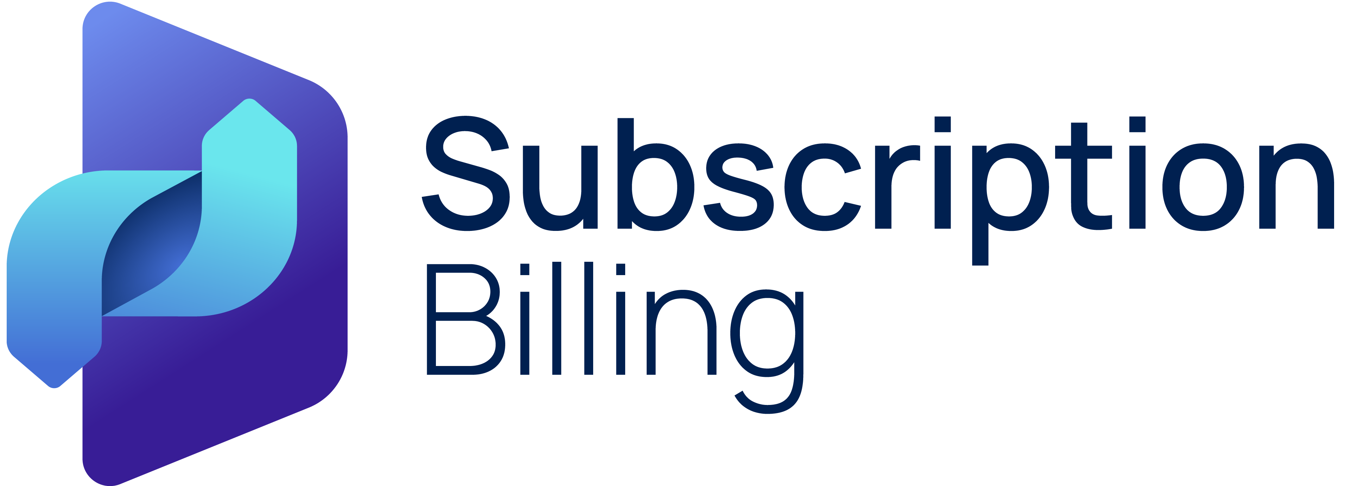

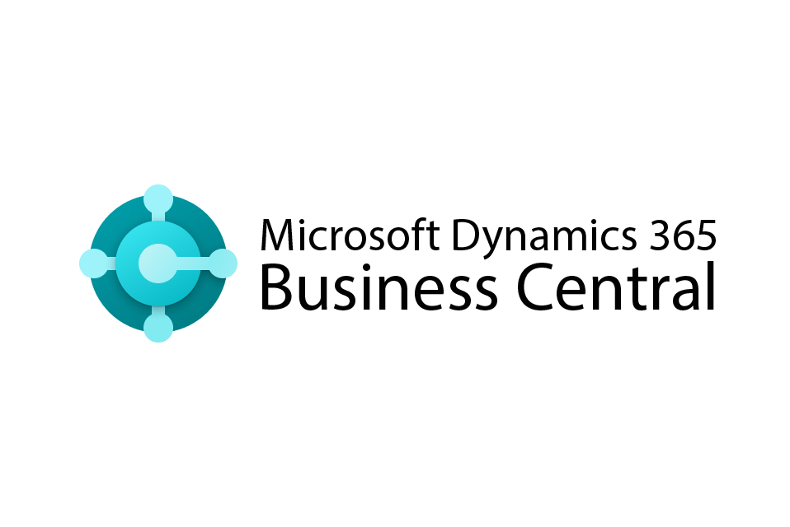


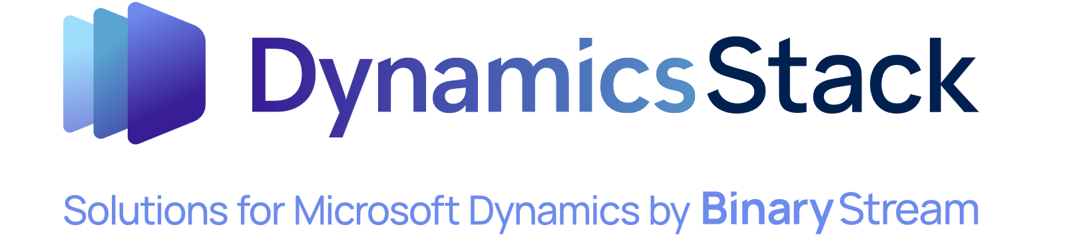
If your finance team is facing any of the following challenges, it may be time to extend your ERP with advanced, fully embedded subscription billing functionality.
Partner logo
When do you need to go beyond Business Central?
You may need to go beyond Business Central if…
You're managing multiple billing models—tiered, usage-based, milestone, or freemium.
You manually adjust invoices for contract changes, pauses, or upgrades.
Your revenue recognition is handled outside your ERP in spreadsheets.
You’re struggling to comply with ASC 606 or IFRS 15.
You lack visibility into MRR, churn, and renewal performance.
You can't automate CPI increases or renewal schedules.
You rely on IT or multiple systems to process deferred revenue.
Subscription Billing and Business Central at-a-glance.
+
Recurring billing
Tiered & usage billing
Contract customization
Revenue deferrals
Compliance (ASC 606/IFRS)
Automated invoicing
Real-time reporting
Customer portal access
You’re not alone.
Thousands of organizations use SBS to simplify billing, ensure compliance, and scale recurring revenue—all from within Business Central.

