Slide 1

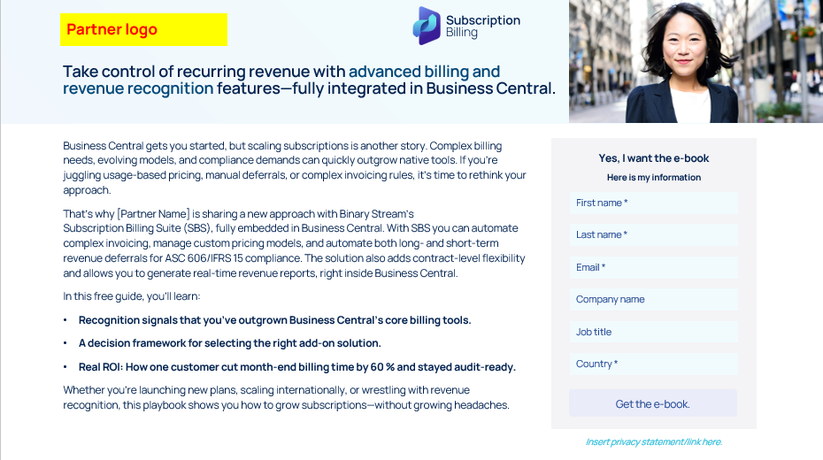
Partner customization guidance
Partner customization guidance.
This landing page template is a starting point you can customize to fit your brand. The sample copy is designed for a gated ebook, but it can easily be adapted to promote the case study or any other downloadable asset.
(Refer to the example on the right to see how brand colors, logos, and other elements can be tailored.)
A few tips as you customize:
Update the visuals. Swap in your brand colors for blocks, overlays, icons, and text headers.
Create your own form. The lead capture form shown here is just an example. You’ll need to build your own version with the fields that make sense for your audience. As a general best practice, collect only what you really need (fewer fields usually lead to higher conversion. And don’t forget to include any relevant privacy or data use disclaimers, especially if you're collecting personal information.
Example of template that has been customized with brand colors, logo, and icons

Slide 2
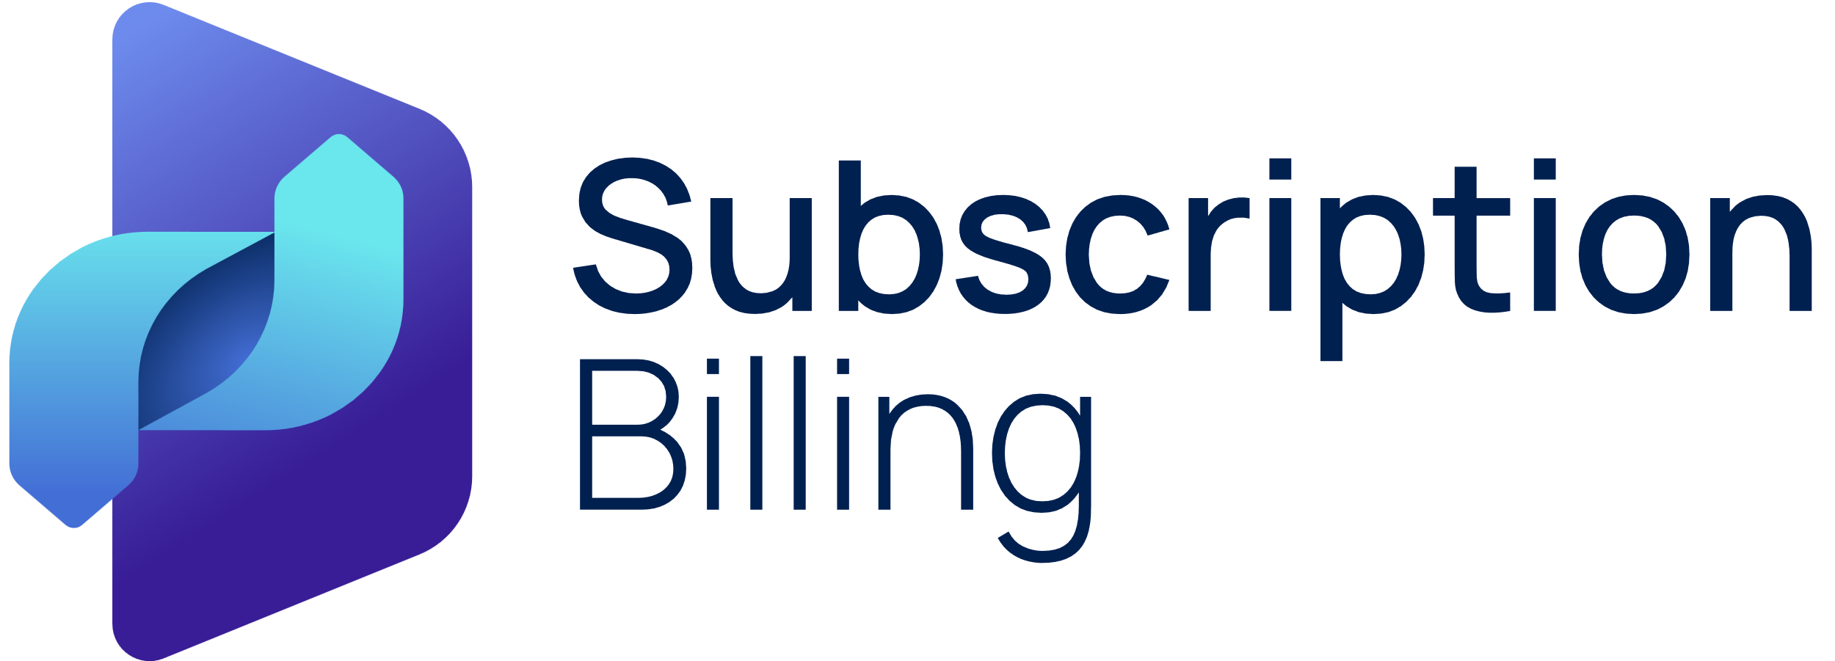

Partner logo
Take control of recurring revenue with advanced billing and revenue recognition features—fully integrated in Business Central.
Business Central gets you started, but scaling subscriptions is another story. Complex billing needs, evolving models, and compliance demands can quickly outgrow native tools. If you’re juggling usage-based pricing, manual deferrals, or complex invoicing rules, it’s time to rethink your approach.
That’s why [Partner Name] is sharing a new approach with Binary Stream’s Subscription Billing Suite (SBS), fully embedded in Business Central. With SBS you can automate complex invoicing, manage custom pricing models, and automate both long‑ and short‑term revenue deferrals for ASC 606/IFRS 15 compliance. The solution also adds contract‑level flexibility and allows you to generate real‑time revenue reports, right inside Business Central.
In this free guide, you’ll learn:
Recognition signals that you’ve outgrown Business Central’s core billing tools.
A decision framework for selecting the right add‑on solution.
Real ROI: How one customer cut month‑end billing time by 60 % and stayed audit‑ready.
Whether you’re launching new plans, scaling internationally, or wrestling with revenue recognition, this playbook shows you how to grow subscriptions—without growing headaches.
Yes, I want the e-book
Here is my information
First name *
Last name *
Email *
Company name
Job title
Country *
Get the e-book
Get the e-book.
Insert privacy statement/link here.

