Slide 1
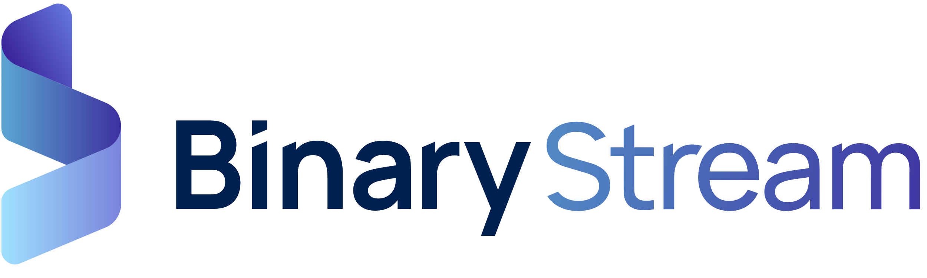


Subscription Billing: Beyond the Business Central Core.
Campaign-in-a-box execution guide.
Resources to drive conversation, engage customers, and drive demand.
July 2025.

Slide 2


Table of contents.
Campaign overview.
  Goals.
Messaging framework.
  Key pain points.
  Value drivers and positioning.
  Copy blocks.
Campaign journey.
  Campaign asset library.
  Demand generation journey.
Activation guidance.
  Brand guidelines.
  Customization tips.
  Execution checklist.

Slide 3

Campaign overview.
This campaign helps you start valuable conversations with Business Central customers whose recurring billing processes are becoming too complex for native tools.
As organizations adopt more advanced pricing models, revenue recognition requirements, and contract terms, Business Central’s built-in billing tools often fall short. This campaign positions Binary Stream’s Subscription Billing as the embedded solution that automates subscription billing and revenue recognition workflows—directly inside Business Central.
We’ve included emails, social posts, gated assets, web banners, a case study, and more. All assets are customizable and co-brandable.
Use this campaign to drive awareness, nurture qualified leads, and show the ROI of moving from manual workarounds to a scalable, compliant billing system.

Slide 4
Messaging framework.
One-line positioning: Extend Business Central with advanced billing and revenue recognition—fully embedded and built for scale.
Common pain points.
Key value drivers.
Use these to speak to the real-world challenges customers are facing:
What Subscription Billing brings to the table:
Automation of subscription-based workflows.
Automate usage-, milestone-, and tier-based billing without manual updates or external systems.
Flexible contract management.
Easily handle proration, escalations, renewals, and mid-term changes, all within Business Central.
Built in revenue deferrals.
Automate revenue and expense deferrals to ensure consistent, compliant recognition schedules.
Real-time subscription insights.
Track churn, renewals, and other key metrics at-a-glance—no need for external reports or spreadsheets.
Audit-ready compliance.
Stay aligned with ASC 606 and IFRS 15 using built-in recognition rules,
“We’re using spreadsheets for revenue recognition.”
“Our billing process takes days—or weeks.”
“We can’t handle upgrades, renewals, or usage-based pricing.”
“We don’t have visibility into MRR, churn, or renewals.”
“Compliance with ASC 606 is manual and inconsistent.”

Slide 5
Copy blocks.
Short (~25 words)
Recurring billing growing complex? Go beyond Business Central’s core tools with Subscription Billing—automate invoicing, revenue recognition, and contract management at scale.
Medium (~50 words)
Business Central gets you started—but manual billing, complex contracts, and compliance risks can slow you down. [Partner Name] introduces Subscription Billing, a fully integrated solution that extends your ERP to support usage-based pricing, revenue deferrals, renewals, and more—all inside Business Central.
Long (~100 words)
Recurring billing starts simple, but scaling it is another story. Business Central’s core tools aren’t built for advanced billing models like usage tiers, milestones, or custom renewals. [Partner Name] introduces Subscription Billing to help you go beyond workarounds. Automate complex invoicing, streamline revenue recognition for ASC 606/IFRS 15, and gain real-time visibility into MRR and churn. Whether you’re a growing SaaS company, healthcare provider, or membership-based organization, Subscription Billing helps you scale subscriptions—without scaling your headaches.

Slide 6
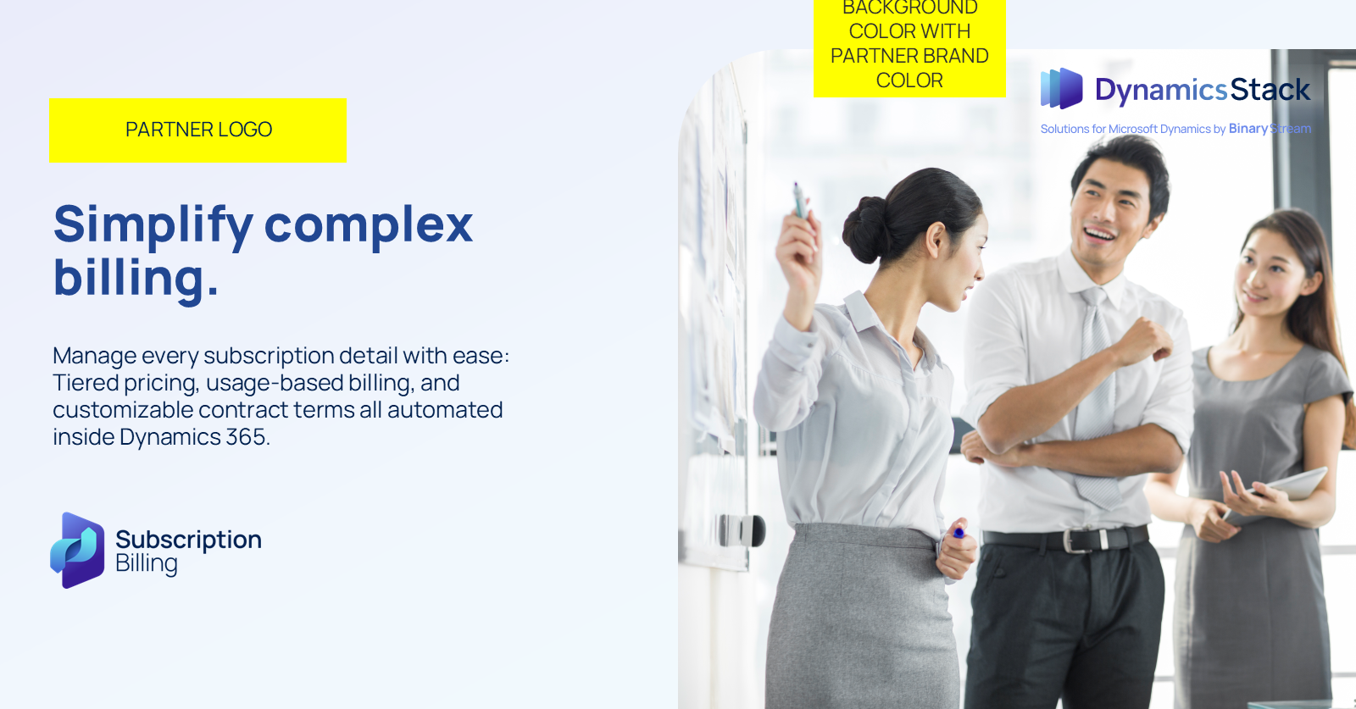
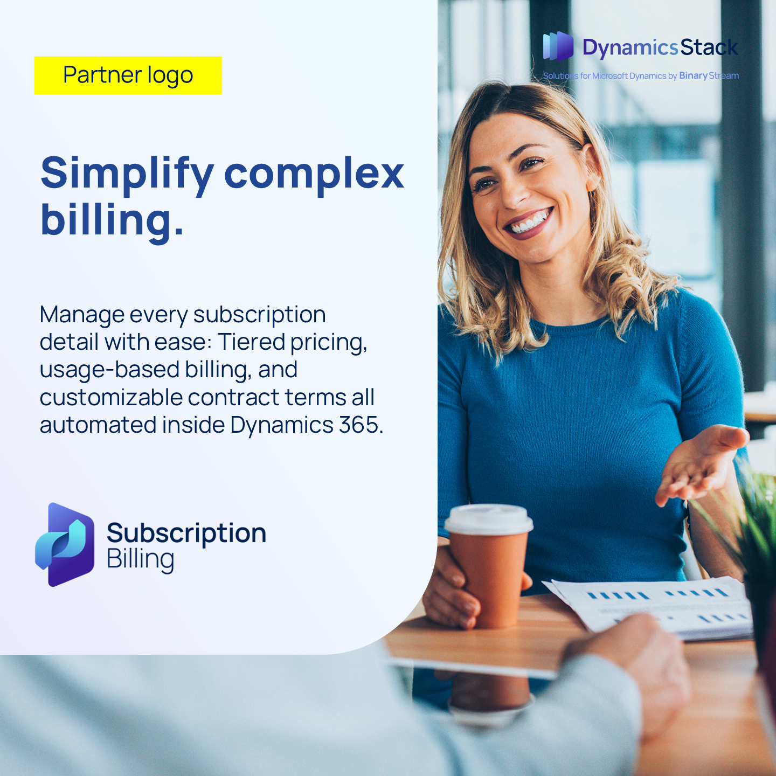
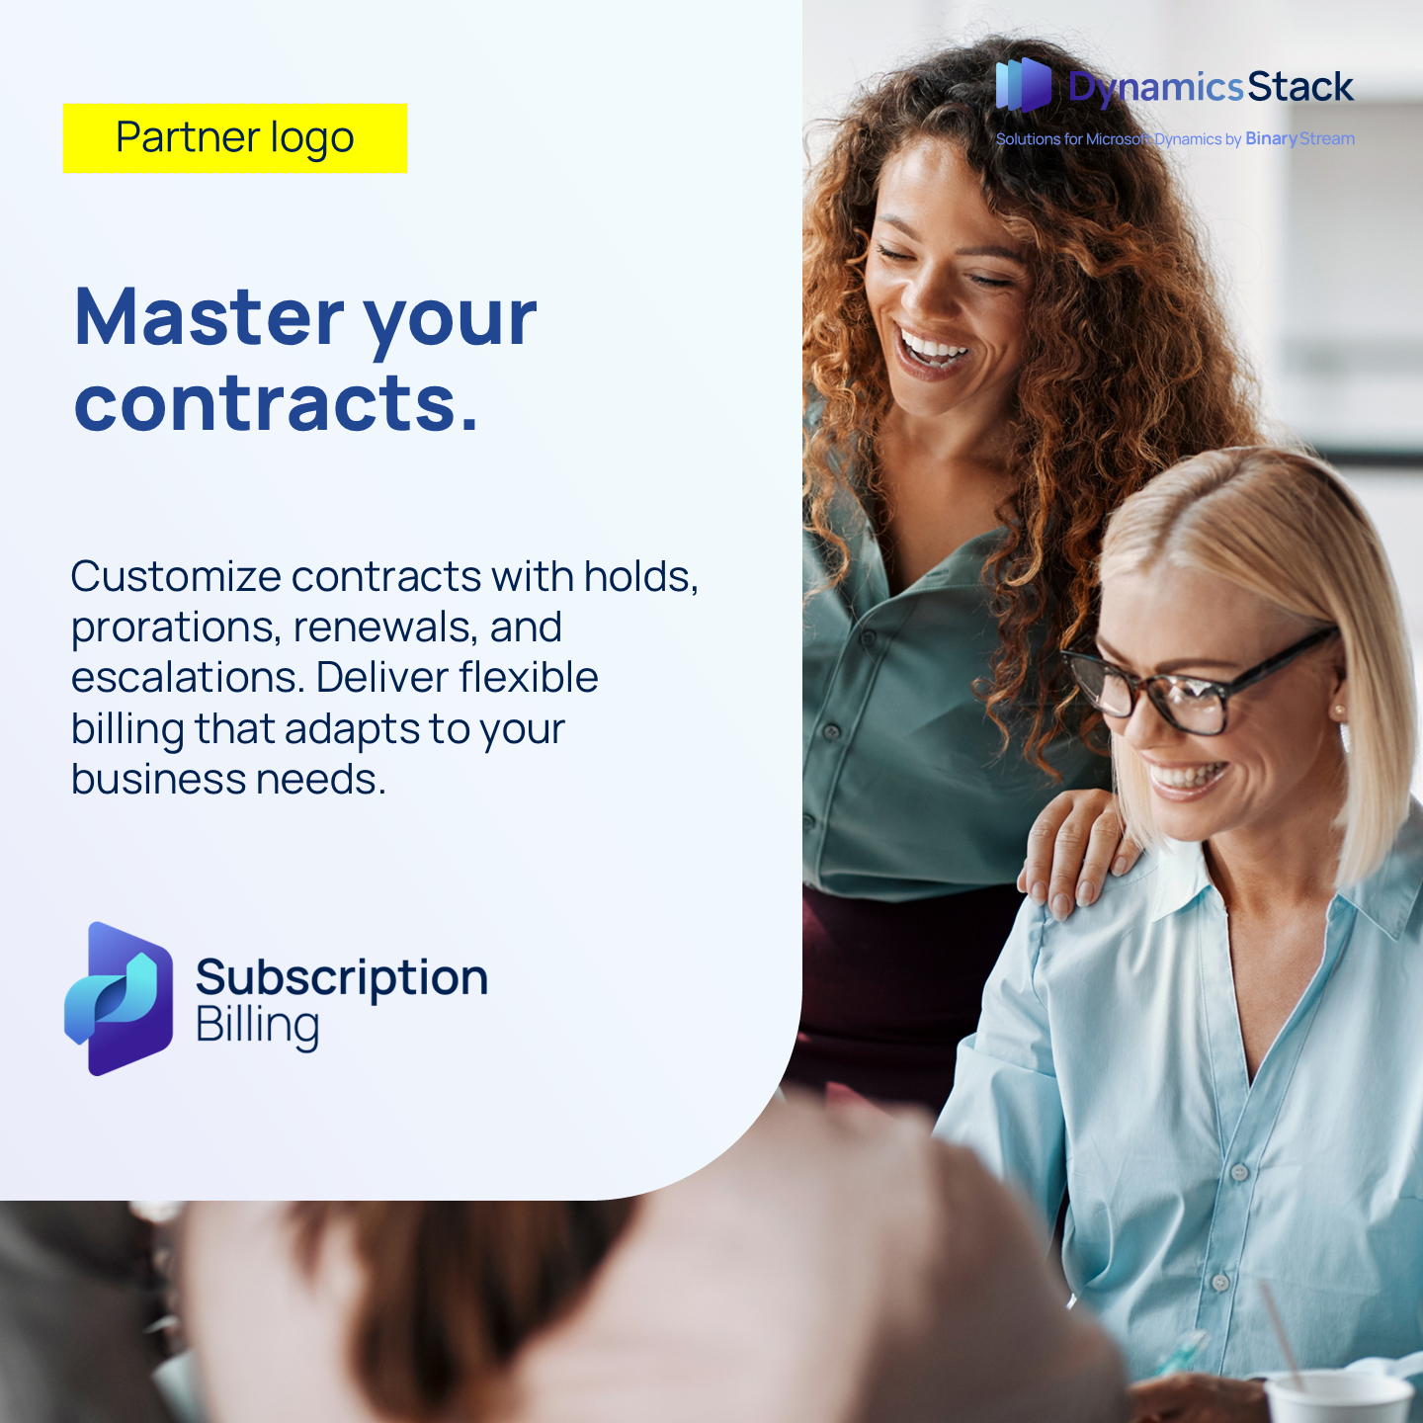


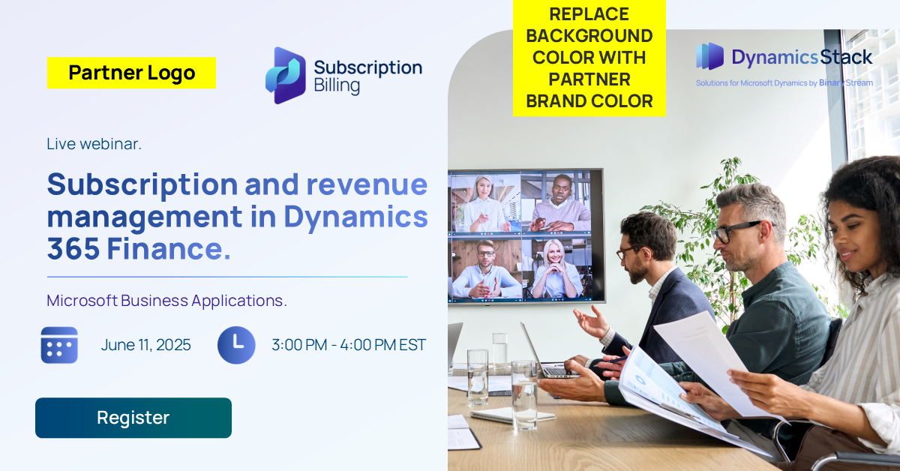
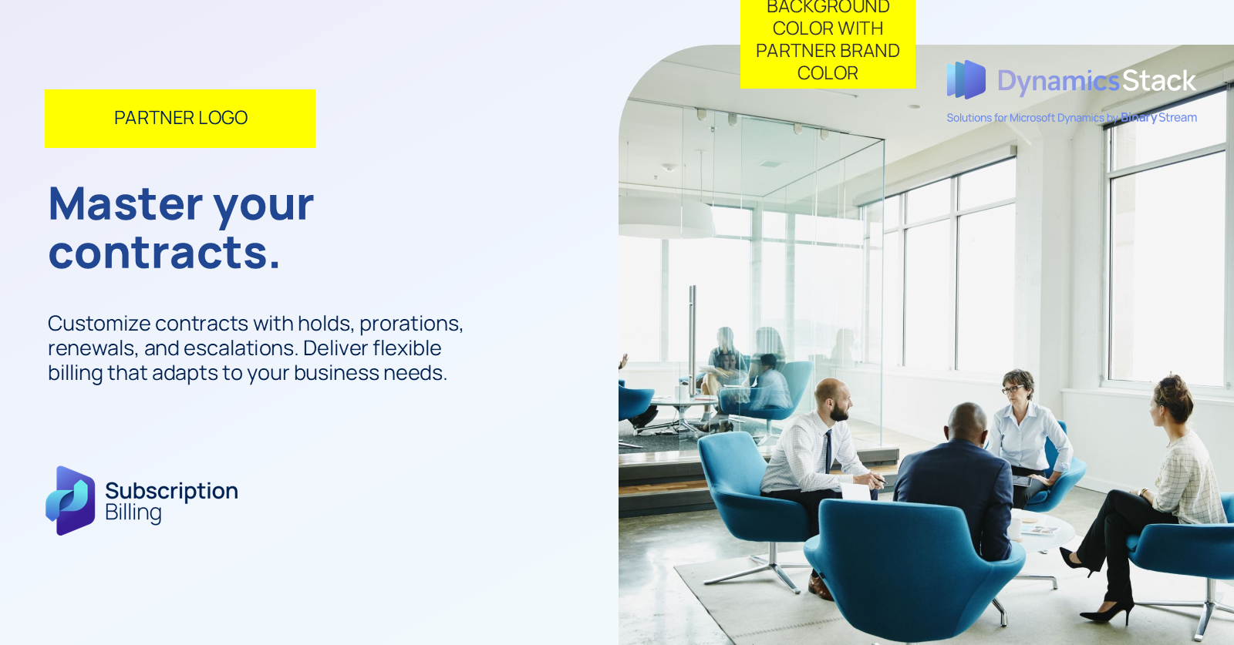
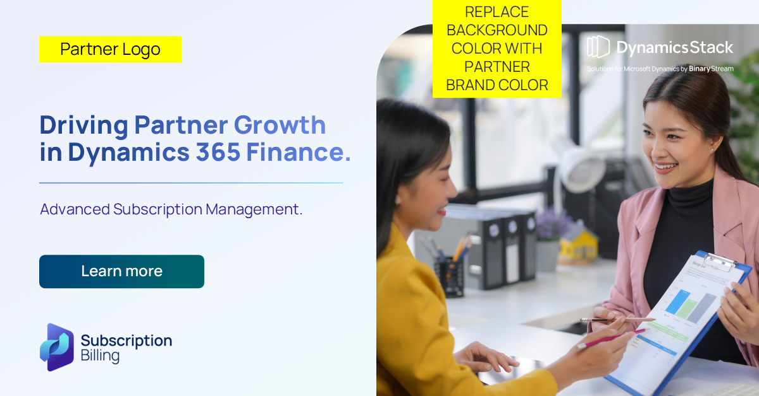

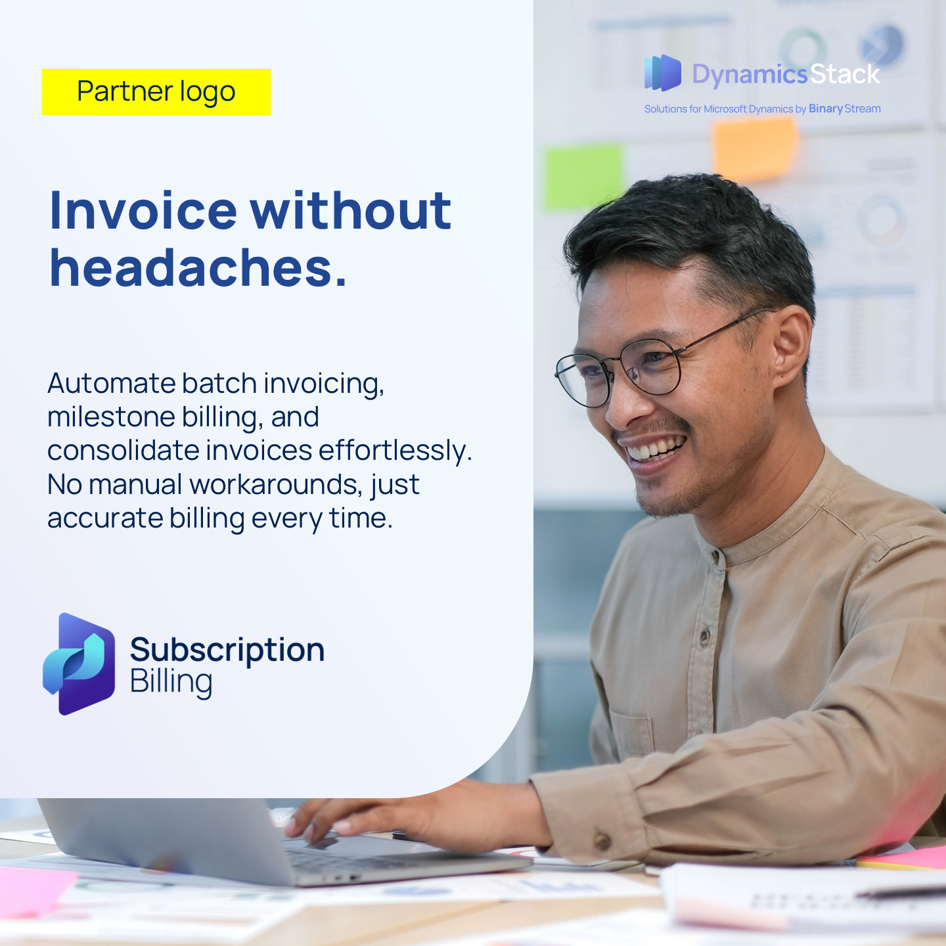
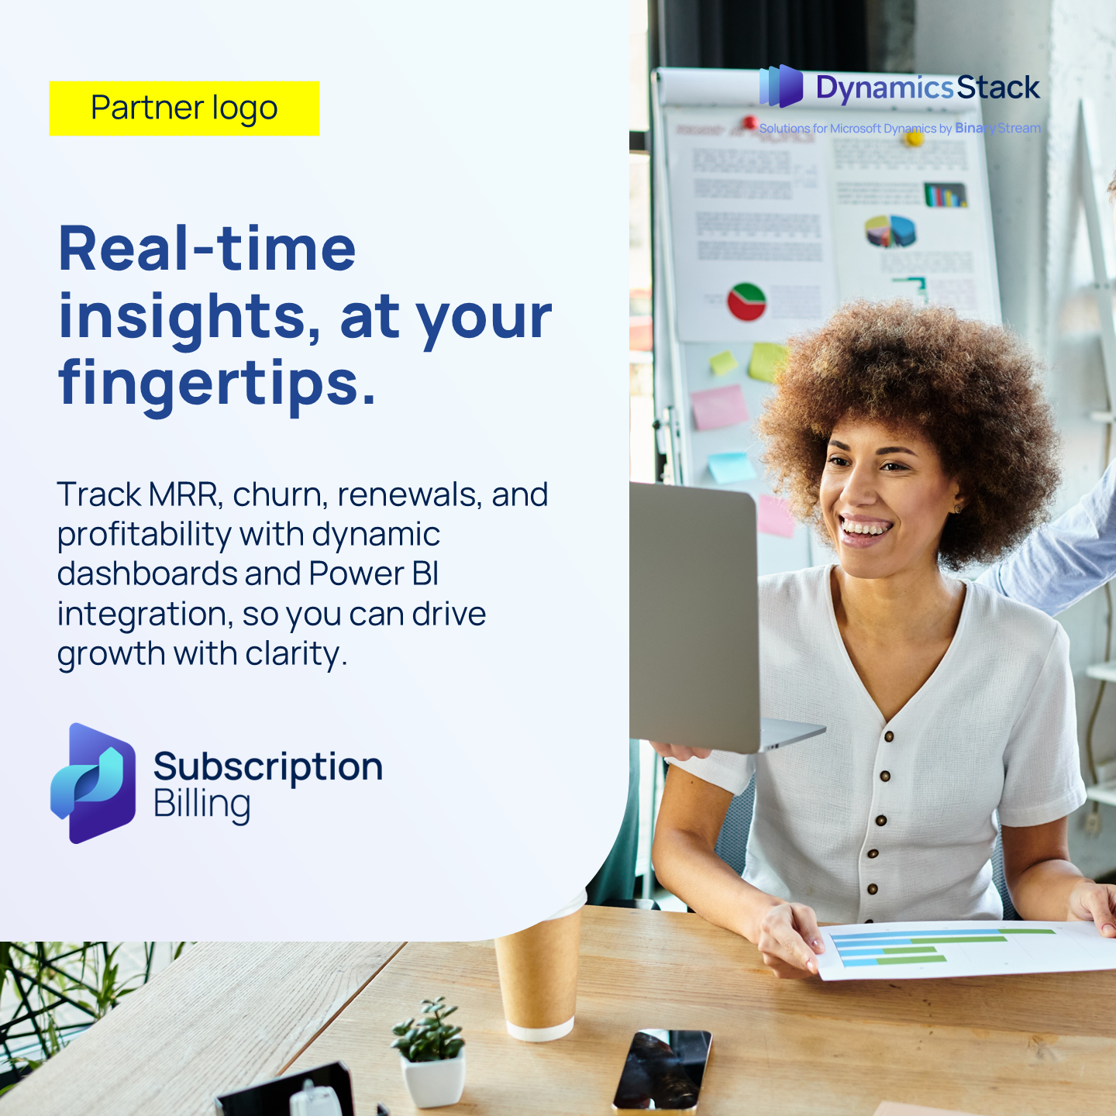
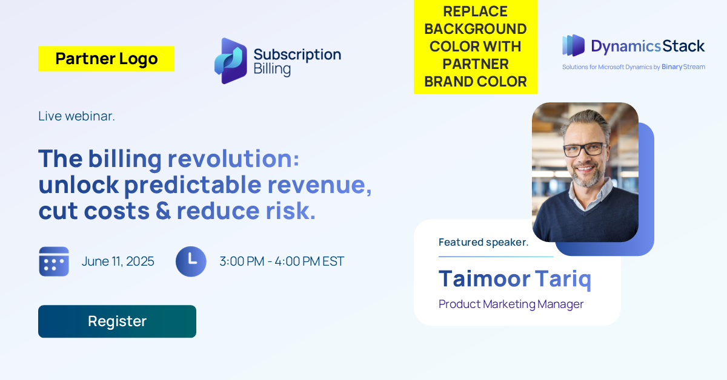
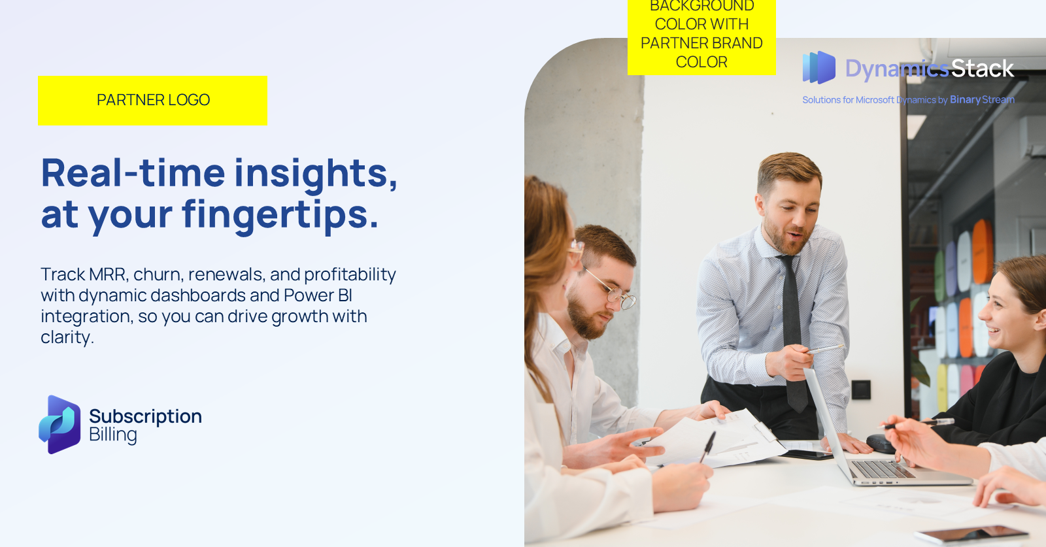
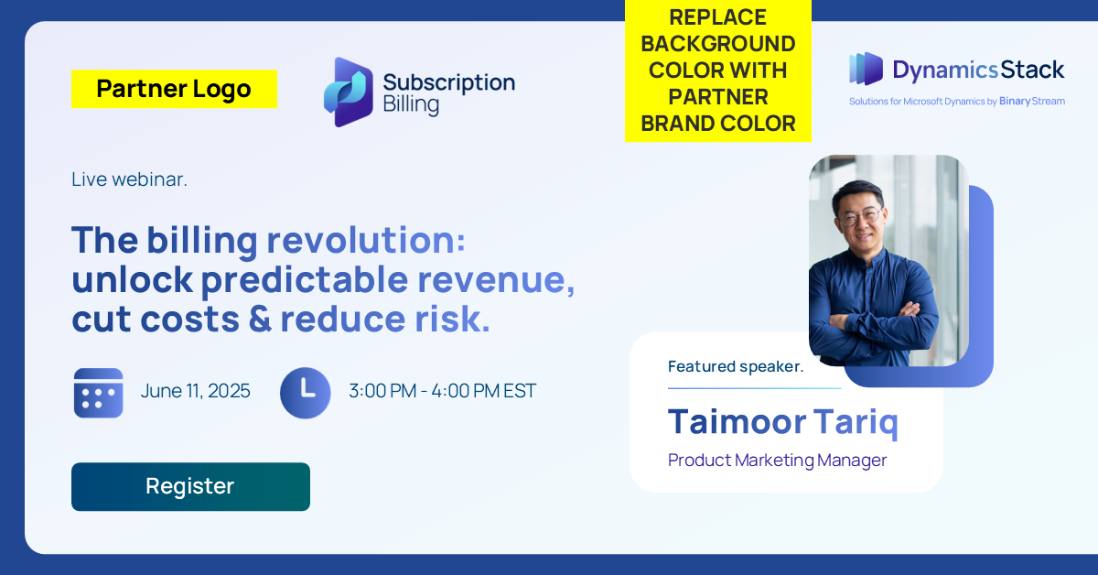

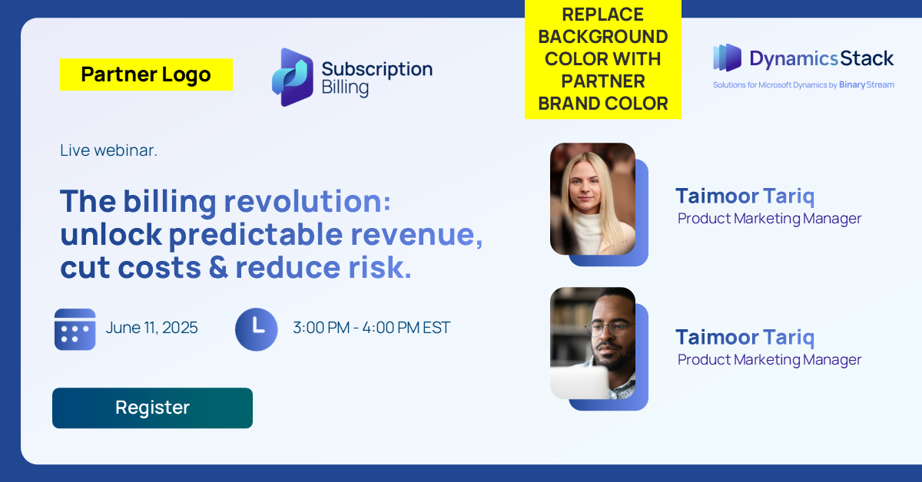
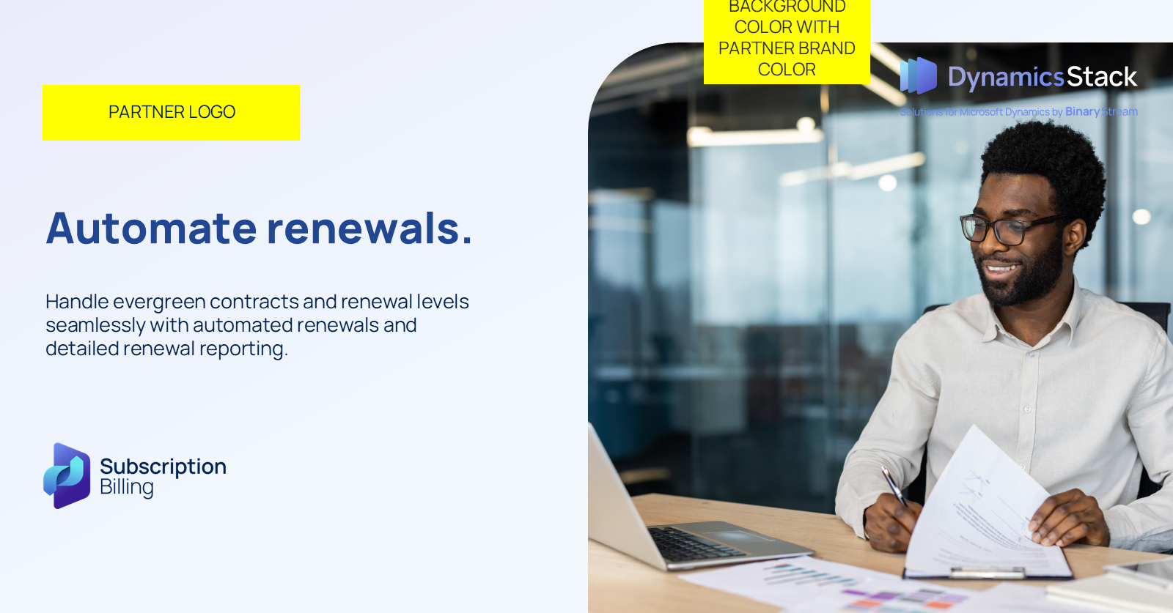
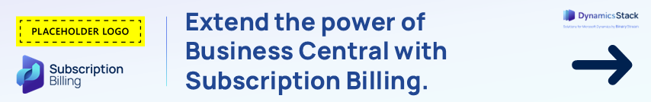
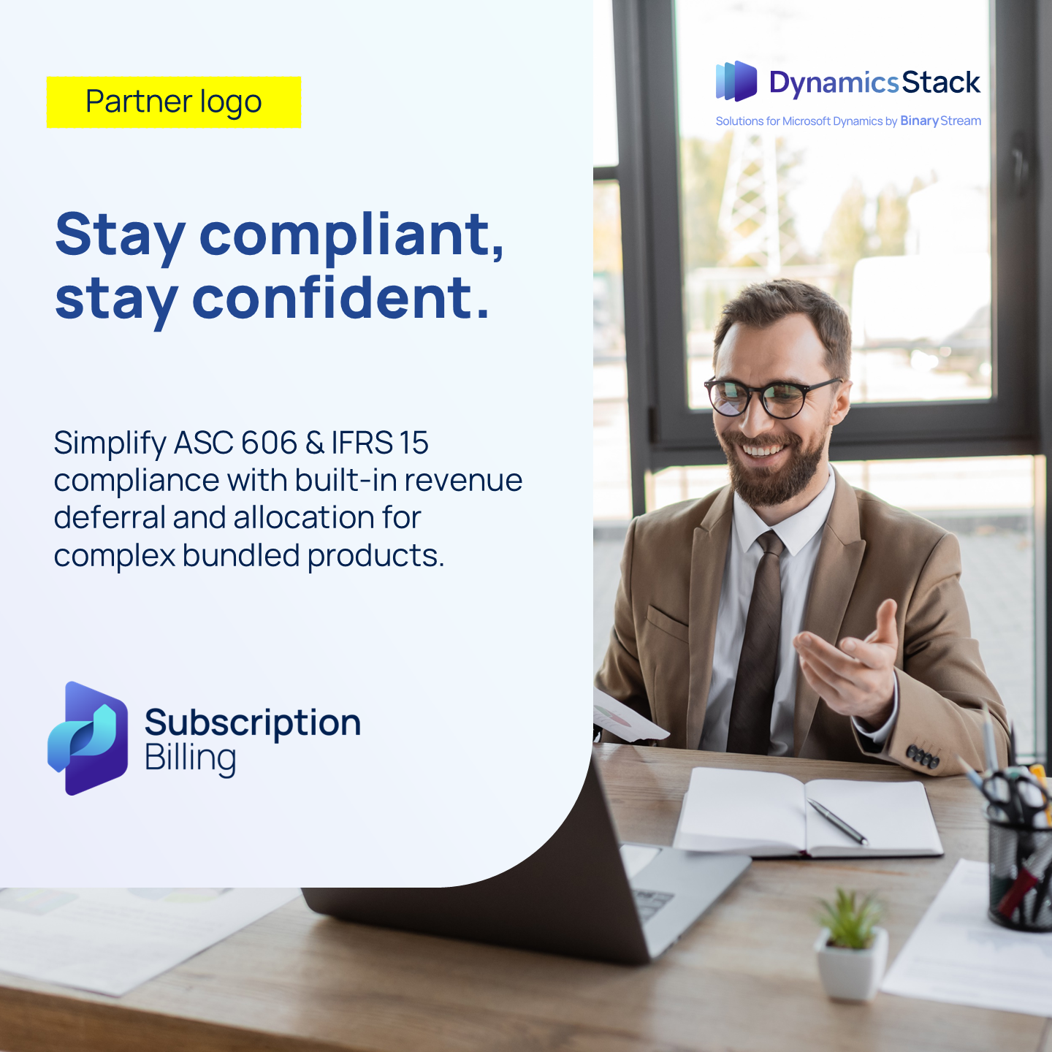
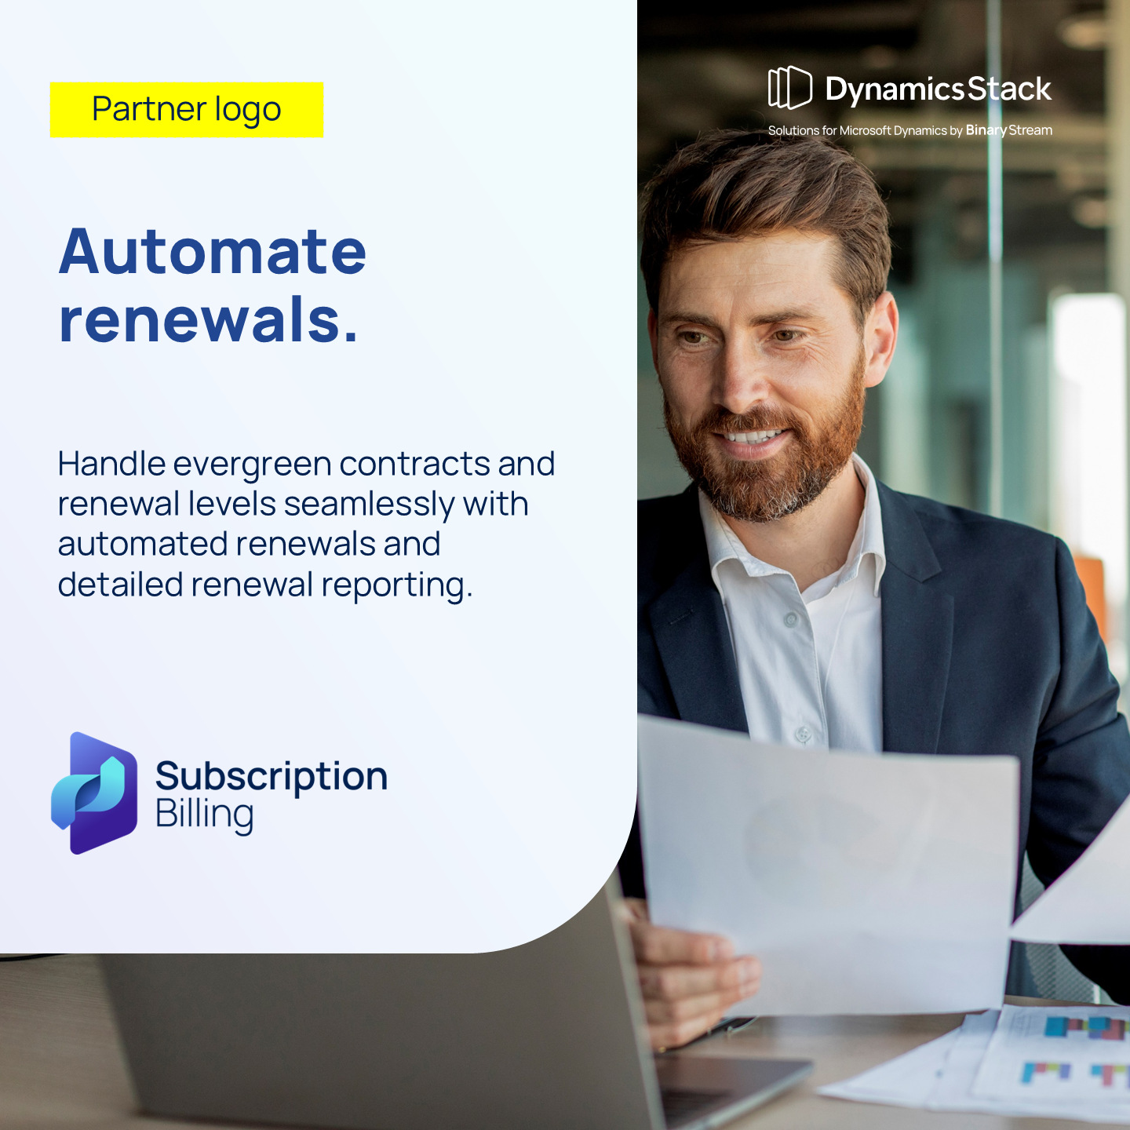
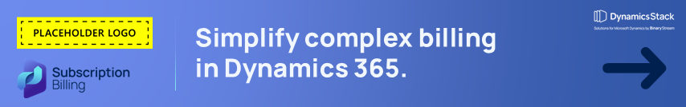

Campaign asset library.
Customizing your assets
The assets in this campaign require you to customize them. You will find placeholder logos that you can replace with your own. You can also modify font, colors, and copy.
You will find customization tips on page 9 of this guide. Each asset also contains specific instructions on how to best customize it.
Ready to start building your pipeline?
Check out the full range of assets on our Campaign Center.
Get support in our Partner Hub.

Slide 7
Demand generation journey.
Use this 4-stage campaignjourney to guide your rollout. Each stage is mapped to specific assets that help move prospects from awareness to action.
Microsoft Fabric
Stage 1: Awareness.
Stage 2: Engagement.
Stage 3: Consideration.
Stage 4: Conversion.
Introduce the concept of going beyond Business Central’s core features.
Promo email: Send to existing contacts directly with the hero asset (ebook) to generate interest and establish credibility.
Social ads: Use paid or organic social ads to drive traffic to the gated landing page with the ebook. Use the gated landing page to capture lead info.
Share more assets and information to encourage consideration. Highlight common challenges and key benefits of extending BC functionality.
Nurture email #1: Is your finance team outgrowing Business Central?
Send to leads and engaged contacts to highlight common challenges and key benefits of extending BC functionality.
Provide real-world validation.
Nurture email #2: How one organization saved $15K in one year.
Share the case study as social proof and to demonstrate ROI
Encourage direct contact or next-step conversations.
Tip for partners: Pace the journey across 2–4 weeks, using soft touchpoints (social + ads) between emails. Retarget and nurture users who engage with gated content using follow-up emails.

Slide 8
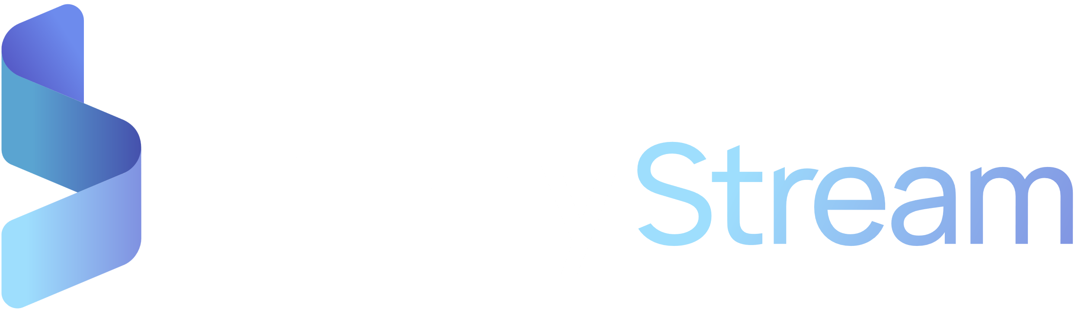

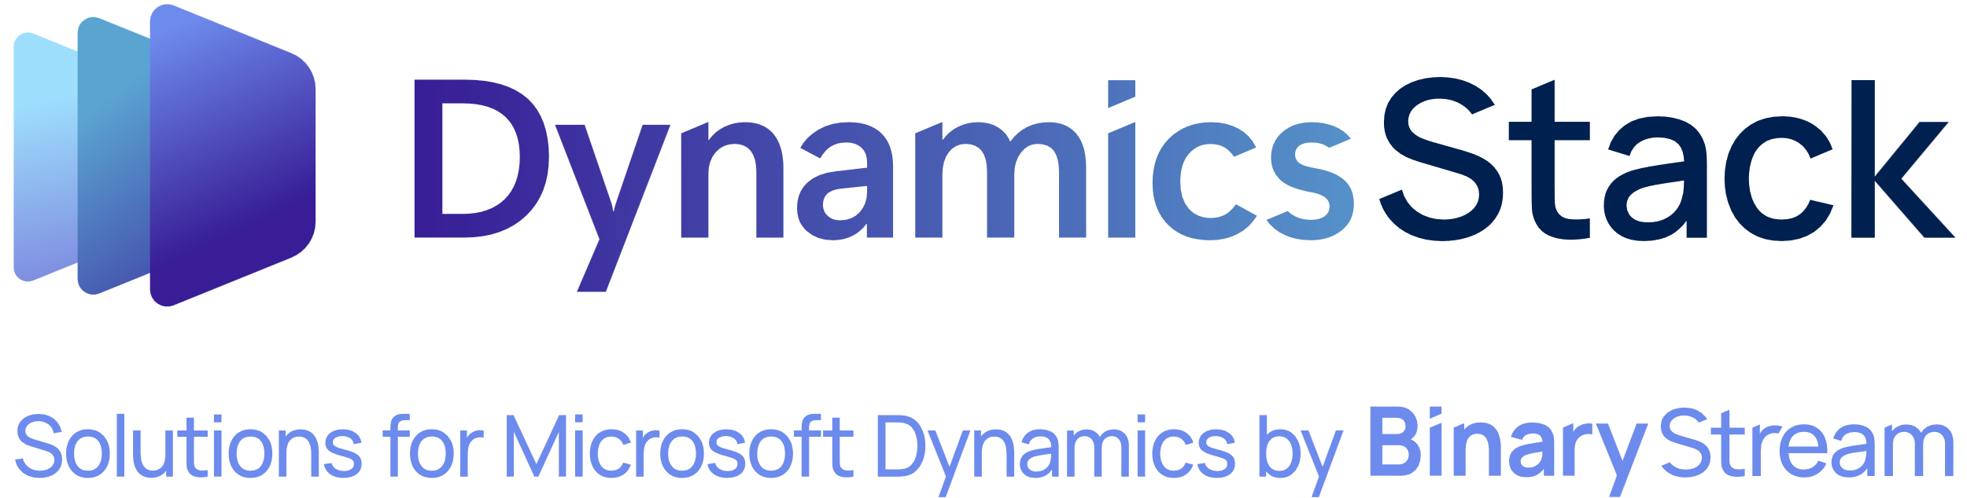
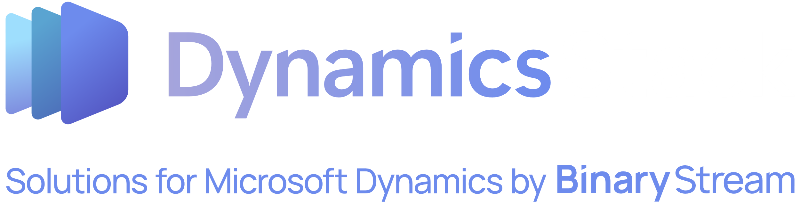



Binary stream logo library.
Download here
Download here
Download here
Download here
Download here
Download here
Download here
Download here

Slide 9
Brand identity – colours and typography.
SBS brand specific palette.
Ochre RGB HEX CMYK 33, 71, 146 #214792 98, 84, 9, 1 | Azure RGB HEX CMYK 109, 139, 237 #6D8BED4 70, 33, 0, 0 | Aqua RGB HEX CMYK 106, 230, 237 #6AE6ED 47, 0, 13, 0
MARIGOLD Subscription Billing Background(15% Opacity) AZURE
AZURE Accents AQUA | PACIFIC Accents / Dark Backgrounds AZURE
Download font here - Manrope

Slide 10
Customization tips.
This campaign is built to be flexible. You can customize most assets with your branding, messaging, and contact information before launching. Here's how to make the most of it:
Branding visual assets.
Update colors, logos, and headers on editable files like the PowerPoint ebook and landing page template.
Replace the placeholder logo with your own on: Ebook, emails, case study, social ads, web banners, etc.
Each asset contains customization instructions and tips.
Customizing copy.
Email templates: Adjust the tone, greeting, or CTA to align with your voice or intended audience market.
Landing page: Use your preferred headline or change the lead capture form based on your CRM or marketing platform.
Using the ebook and case study
Open the provided PowerPoint file.
Add your logo, colors, and contact info to specified sections.
Export as PDF and use it as your gated asset or send directly to qualified leads.
Helpful reminders.
Keep messaging consistent with the campaign’s value proposition: Business Central is great—but sometimes you need more.
When in doubt, less is more. Don’t overcrowd visuals or over-edit CTA copy.

Slide 11
Execution checklist.
Prepare.
Review the full campaign assets and execution guide.
Align campaign goals with your sales and marketing teams.
Identify key audience segments (existing clients, net-new leads, etc.).
Customize assets.
Add your branding to the ebook, case study, social ads, emails, etc.
Customize the landing page with your logo, colors, and form.
Update email copy and CTAs to reflect your voice and offer.
Export the ebook as a branded PDF and gate it behind a landing page.
Launch the campaign.
Post social ads and organic content across your channels to drive traffic to the landing page.
Send Email #1 to existing contacts to generate interest.
Send Nurture email #1 as a follow-up.
Share the case study and Nurture email #2 to drive consideration.
Invite qualified leads to book a discovery call or request a demo.
Track & follow up.
Monitor form submissions, opens, clicks, and downloads.
Share results with your internal team.
Follow up with engaged leads via email or outbound outreach.
Report back on wins and learnings to your Binary Stream contact.

Slide 12

Thank you!

