Slide 1



REPLACE BACKGROUND COLOR WITH PARTNER BRAND COLOR
PARTNER LOGO
Simplify complex billing.
Manage every subscription detail with ease: Tiered pricing, usage-based billing, and customizable contract terms all automated inside Dynamics 365.

Slide 2


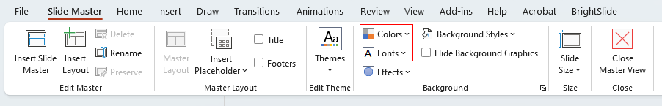
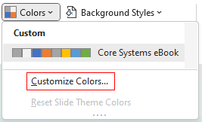

REPLACE BACKGROUND COLOR WITH PARTNER BRAND COLOR
Use this PowerPoint as a starting point to build a custom-branded asset by adding your own logos, fonts, colours, and messaging.
Areas marked in yellow indicate where your custom branding, content, or visuals should be applied.
PARTNER LOGO
1
Go to the Slide Master to set up your brand fonts and colour palette.
We've already included our brand colours for this specific solution in the template—feel free to adjust as needed to align with your use case.
Master your contracts.
Customize contracts with holds, prorations, renewals, and escalations. Deliver flexible billing that adapts to your business needs.
2
Replace any yellow-highlighted text with copy tailored to your brand. Be sure to match the font colour to the rest of the slide and adjust the text style and layout if needed.
3
Add your organization’s logo and icons throughout the slides and Slide Master. You may also swap out images to suit your audience or branding. Please note: if you use the included visuals, they are intended only for use within this template and should not be repurposed elsewhere.
4
Once complete, name your file and choose where to save it. Remove any yellow highlighting and extra instructional elements. Then, go to the File menu and select Export to save your final version as a PNG.
This slide is sized to export to 1200x627 pixels.

Slide 3

REPLACE BACKGROUND COLOR WITH PARTNER BRAND COLOR
PARTNER LOGO
Invoice without headaches.
Automate batch invoicing, milestone billing, and consolidate invoices effortlessly. No manual workarounds, just accurate billing every time.

Slide 4

REPLACE BACKGROUND COLOR WITH PARTNER BRAND COLOR
PARTNER LOGO
Real-time insights, at your fingertips.
Track MRR, churn, renewals, and profitability with dynamic dashboards and Power BI integration, so you can drive growth with clarity.

Slide 5


REPLACE BACKGROUND COLOR WITH PARTNER BRAND COLOR
PARTNER LOGO
Stay compliant, stay confident.
Simplify ASC 606 & IFRS 15 compliance with built-in revenue deferral and allocation for complex bundled products.

Slide 6
REPLACE BACKGROUND COLOR WITH PARTNER BRAND COLOR
PARTNER LOGO
Automate renewals.
Handle evergreen contracts and renewal levels seamlessly with automated renewals and detailed renewal reporting.

