Slide 1



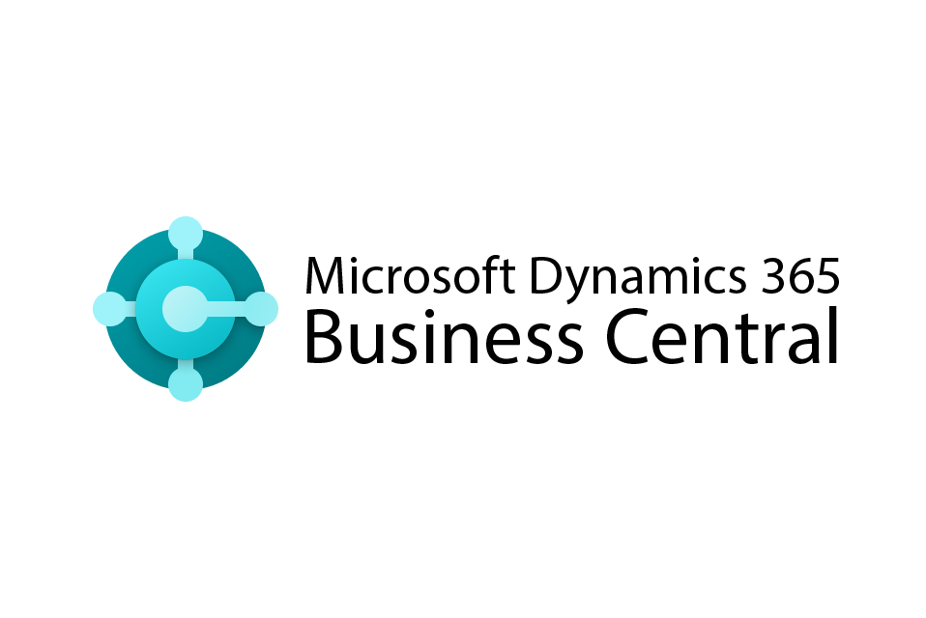



When do you need to go beyond Business Central?
If your organization is experiencing any of the following challenges, it might be time to extend your ERP with advanced multi-entity capabilities.
Partner logo
You may need to go beyond Business Central if…
You're managing 3+ legal entities or companies.
You're manually reconciling intercompany transactions.
Your team exports to Excel for consolidated reporting.
You maintain separate master records (vendors, customers, etc.) per entity.
Your month-end close takes over a week.
You're duplicating transactions across environments.
Audit trails are fragmented across tenants.
You’re planning to scale into new markets, regions, or business models.
Multi-Entity Management and Business Central at-a-glance.
+
Basic intercompany
Cross-entity automation
Shared master records
Real-time consolidation
Multi-entity reporting
You’re not alone.
Thousands of growing organizations use MEM to simplify financial operations and scale smarter.

