Slide 1



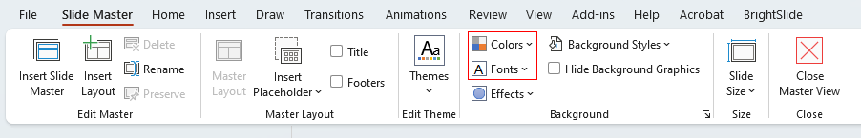

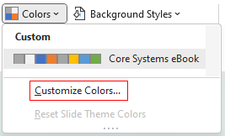

Use this PowerPoint as a starting point to build a custom-branded asset by adding your own logos, fonts, colours, and messaging.
Automate intercompany transactions in Business Central.
Areas marked in yellow indicate where your custom branding, content, or visuals should be applied.
1
Go to the Slide Master to set up your brand fonts and colour palette.
We've already included our brand colours for this specific solution in the template—feel free to adjust as needed to align with your use case.
Learn more
2
Replace any yellow-highlighted text with copy tailored to your brand. Be sure to match the font colour to the rest of the slide and adjust the text style and layout if needed.
3
Add your organization’s logo and icons throughout the slides and Slide Master. You may also swap out images to suit your audience or branding. Please note: if you use the included visuals, they are intended only for use within this template and should not be repurposed elsewhere.
4
Once complete, name your file and choose where to save it. Remove any yellow highlighting and extra instructional elements. Then, go to the File menu and select Export to save your final version as a PNG.
This slide is sized to export to 300x600 pixels.

Slide 2

Use this PowerPoint as a starting point to build a custom-branded asset by adding your own logos, fonts, colours, and messaging.
Extend the power of Business Central with Multi-Entity Management.
Areas marked in yellow indicate where your custom branding, content, or visuals should be applied.
1
Go to the Slide Master to set up your brand fonts and colour palette.
We've already included our brand colours for this specific solution in the template—feel free to adjust as needed to align with your use case.
Learn more
2
Replace any yellow-highlighted text with copy tailored to your brand. Be sure to match the font colour to the rest of the slide and adjust the text style and layout if needed.
3
Add your organization’s logo and icons throughout the slides and Slide Master. You may also swap out images to suit your audience or branding. Please note: if you use the included visuals, they are intended only for use within this template and should not be repurposed elsewhere.
4
Once complete, name your file and choose where to save it. Remove any yellow highlighting and extra instructional elements. Then, go to the File menu and select Export to save your final version as a PNG.
This slide is sized to export to 300x600 pixels.

