Slide 1

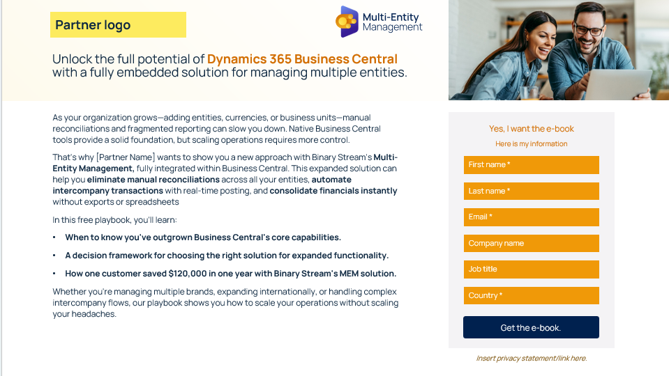
Partner customization guidance.
This landing page template is a starting point you can customize to fit your brand. The sample copy is designed for a gated ebook, but it can easily be adapted to promote the case study or any other downloadable asset.
(Refer to the example on the right to see how brand colors, logos, and other elements can be tailored.)
A few tips as you customize:
Update the visuals. Swap in your brand colors for blocks, overlays, icons, and text headers.
Create your own form. The lead capture form shown here is just an example. You’ll need to build your own version with the fields that make sense for your audience. As a general best practice, collect only what you really need (fewer fields usually lead to higher conversion. And don’t forget to include any relevant privacy or data use disclaimers, especially if you're collecting personal information.
Example of template that has been customized with brand colors, logo, and icons

Slide 2
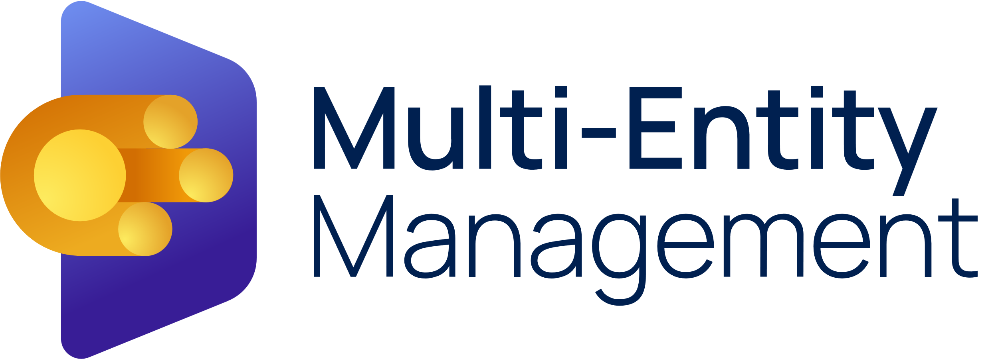

Partner logo
Unlock the full potential of Dynamics 365 Business Central with a fully embedded solution for managing multiple entities.
As your organization grows—adding entities, currencies, or business units—manual reconciliations and fragmented reporting can slow you down. Native Business Central tools provide a solid foundation, but scaling operations requires more control.
That's why [Partner Name] wants to show you a new approach with Binary Stream's Multi-Entity Management, fully integrated within Business Central. This expanded solution can help you eliminate manual reconciliations across all your entities, automate intercompany transactions with real-time posting, and consolidate financials instantly without exports or spreadsheets
In this free playbook, you'll learn:
When to know you've outgrown Business Central's core capabilities.
A decision framework for choosing the right solution for expanded functionality.
How one customer saved $120,000 in one year with Binary Stream's MEM solution.
Whether you're managing multiple brands, expanding internationally, or handling complex intercompany flows, our playbook shows you how to scale your operations without scaling your headaches.
Yes, I want the e-book
Here is my information
First name *
Last name *
Email *
Company name
Job title
Country *
Get the e-book
Get the e-book.
Insert privacy statement/link here.

