Slide 1



Multi-Entity Management: Beyond the Business Central Core.
Campaign-in-a-box execution guide.
Resources to drive conversation, engage customers, and drive demand.
July 2025.

Slide 2


Table of contents.
Campaign overview.
  Goals.
  Target audience.
Messaging framework.
  Key pain points.
  Value drivers and positioning.
  Copy blocks.
Campaign journey.
  Campaign asset library.
  Demand generation journey.
Activation guidance.
  Brand guidelines.
  Customization tips.
  Execution checklist.

Slide 3

Campaign overview.
This campaign helps you start meaningful conversations with Dynamics 365 Business Central users who are starting to feel the strain of multi-entity operations.
As organizations grow—adding entities, or regions—the native capabilities of Business Central can’t always keep up. This campaign positions Binary Stream’s Multi-Entity Management (MEM) as the natural next step: a fully embedded solution that extends Business Central without disrupting core workflows.
We’ve included emails, social posts, gated assets, web banners, a case study, and more. All assets are customizable and co-brandable.
Use this campaign to drive awareness, generate leads, and close deals by offering customers educational resources that clearly show the value of going beyond native intercompany and consolidation features.

Slide 4
Messaging framework.
One-line positioning: Extend Business Central with fully integrated multi-entity functionality, so you can simplify intercompany operations, eliminate manual processes, and scale with confidence.
Common pain points.
Key value drivers.
Use these to speak to the real-world challenges customers are facing:
What MEM brings to the table:
Automation of intercompany transactions.
Post once, and transactions flow seamlessly across all entities—no manual re-entry.
Real-time consolidated reporting.
Access financials across companies, divisions, and locations with no need to export to Excel.
Shared master records.
Share customers, vendors, items, and other records across entities, reducing duplication and errors.
Simplified compliance and audit readiness.
Keep everything in one system, with full visibility and traceability for auditors.
Scalability without overhead.
Add new entities, divisions, or markets without adding complexity to your financial workflows.
“We’re spending too much time reconciling across entities.”
“Our month-end close takes too long.”
“We’re duplicating customers, vendors, and items across environments.”
“We need better visibility across companies and locations.”
“Our audit trail is fragmented and inconsistent.”

Slide 5
Copy blocks.
Short (~25 words)
Managing multiple entities in Business Central? It may be time to go beyond the core. [Partner Name] brings you Multi-Entity Management. Automate intercompany, consolidate in real time, and simplify multi-entity finance.
Medium (~50 words)
Business Central gives you a solid foundation—but growing organizations often need more. [Partner Name] introduces Multi-Entity Management, a fully integrated solution that automates intercompany transactions, enables real-time consolidated reporting, and eliminates manual reconciliations. It’s a smarter way to scale your financial operations—without adding extra systems or complexity.
Long (~100 words)
Business Central is powerful, but companies aiming for high-volume, multi-entity operations sometimes find that they need more. As your company grows, managing intercompany transactions, consolidating reports, and duplicating master records becomes time-consuming and error-prone. [Partner Name] introduces Multi-Entity Management (MEM), a fully integrated solution that extends Business Central’s native capabilities. Automate intercompany workflows, consolidate financials in real time, and stay audit-ready with shared data and centralized control. Whether you're expanding into new markets, managing multiple brands, or preparing for acquisition, MEM helps you scale your operations—without scaling your headaches.

Slide 6
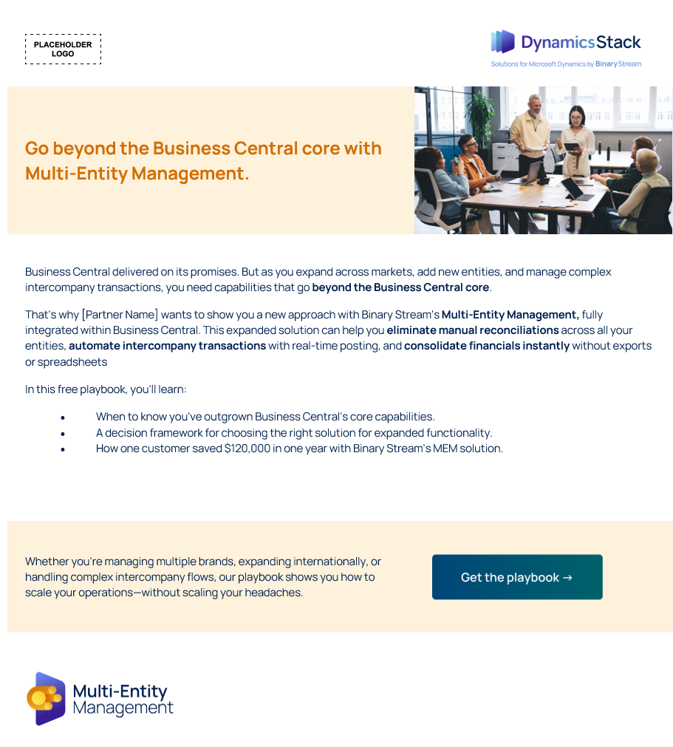





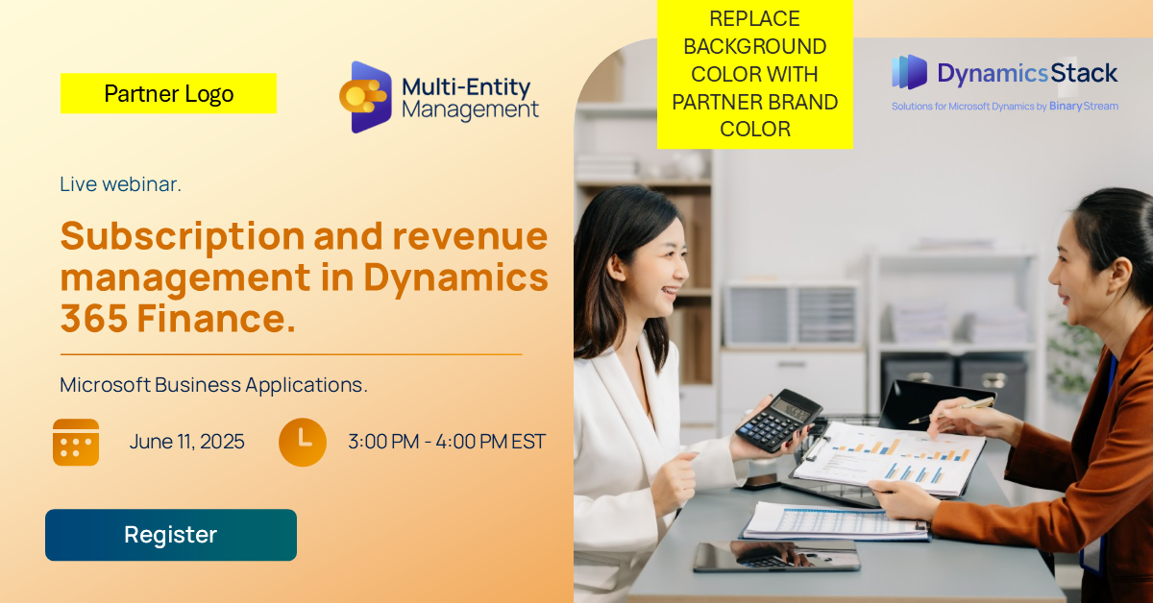
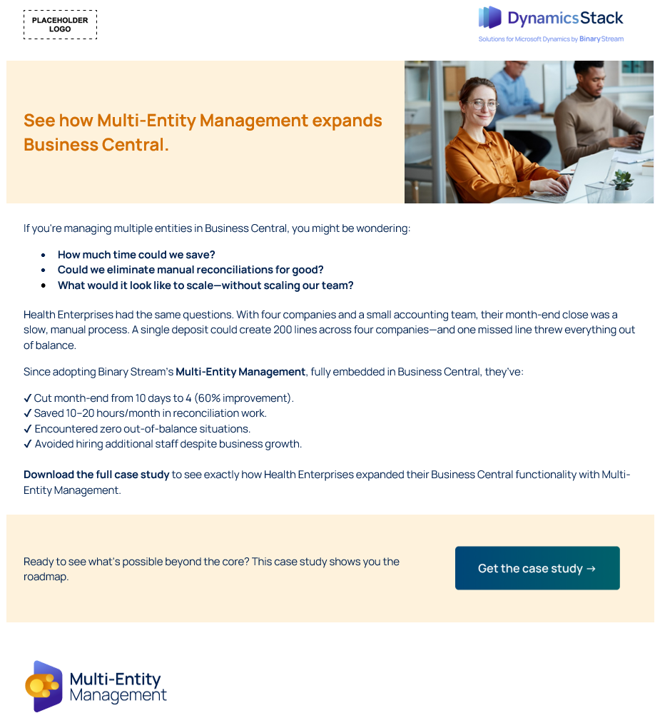

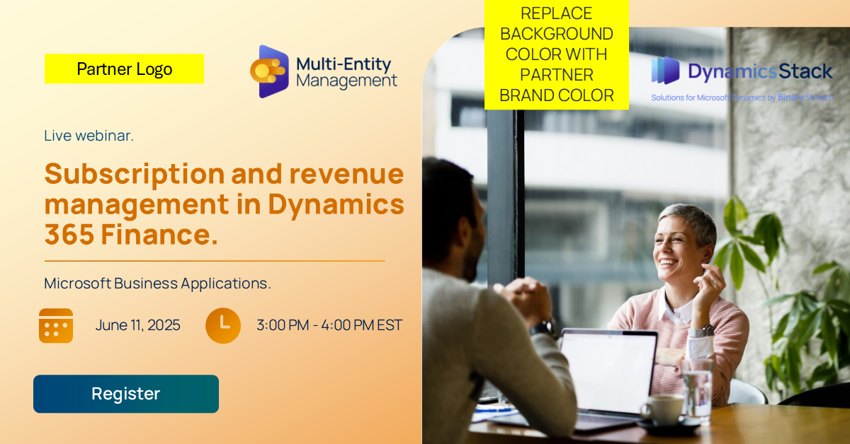

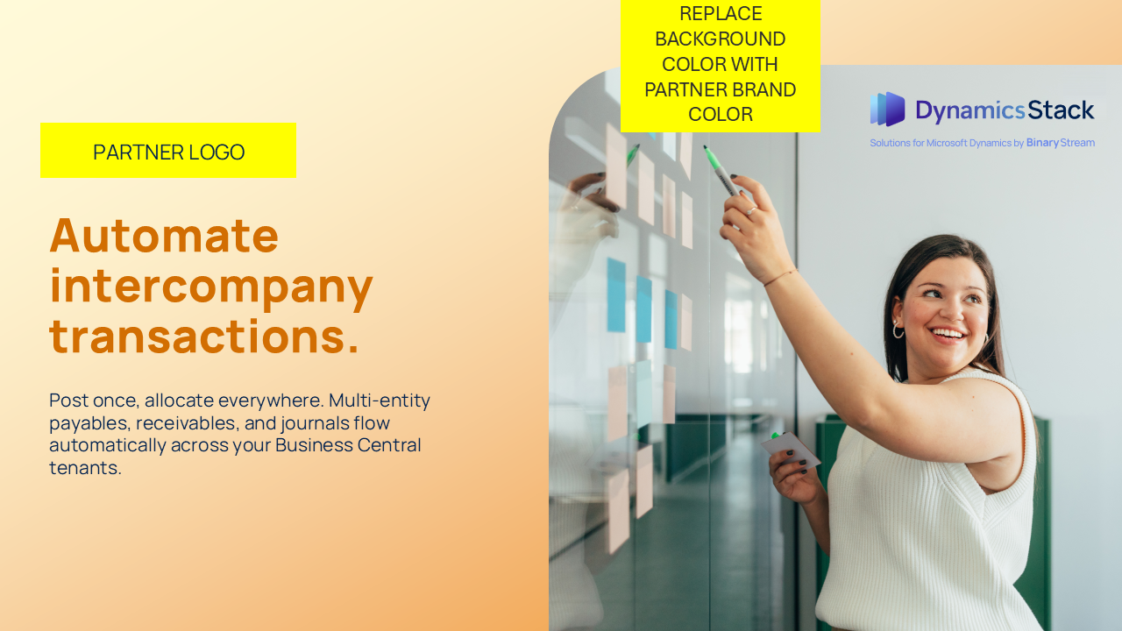
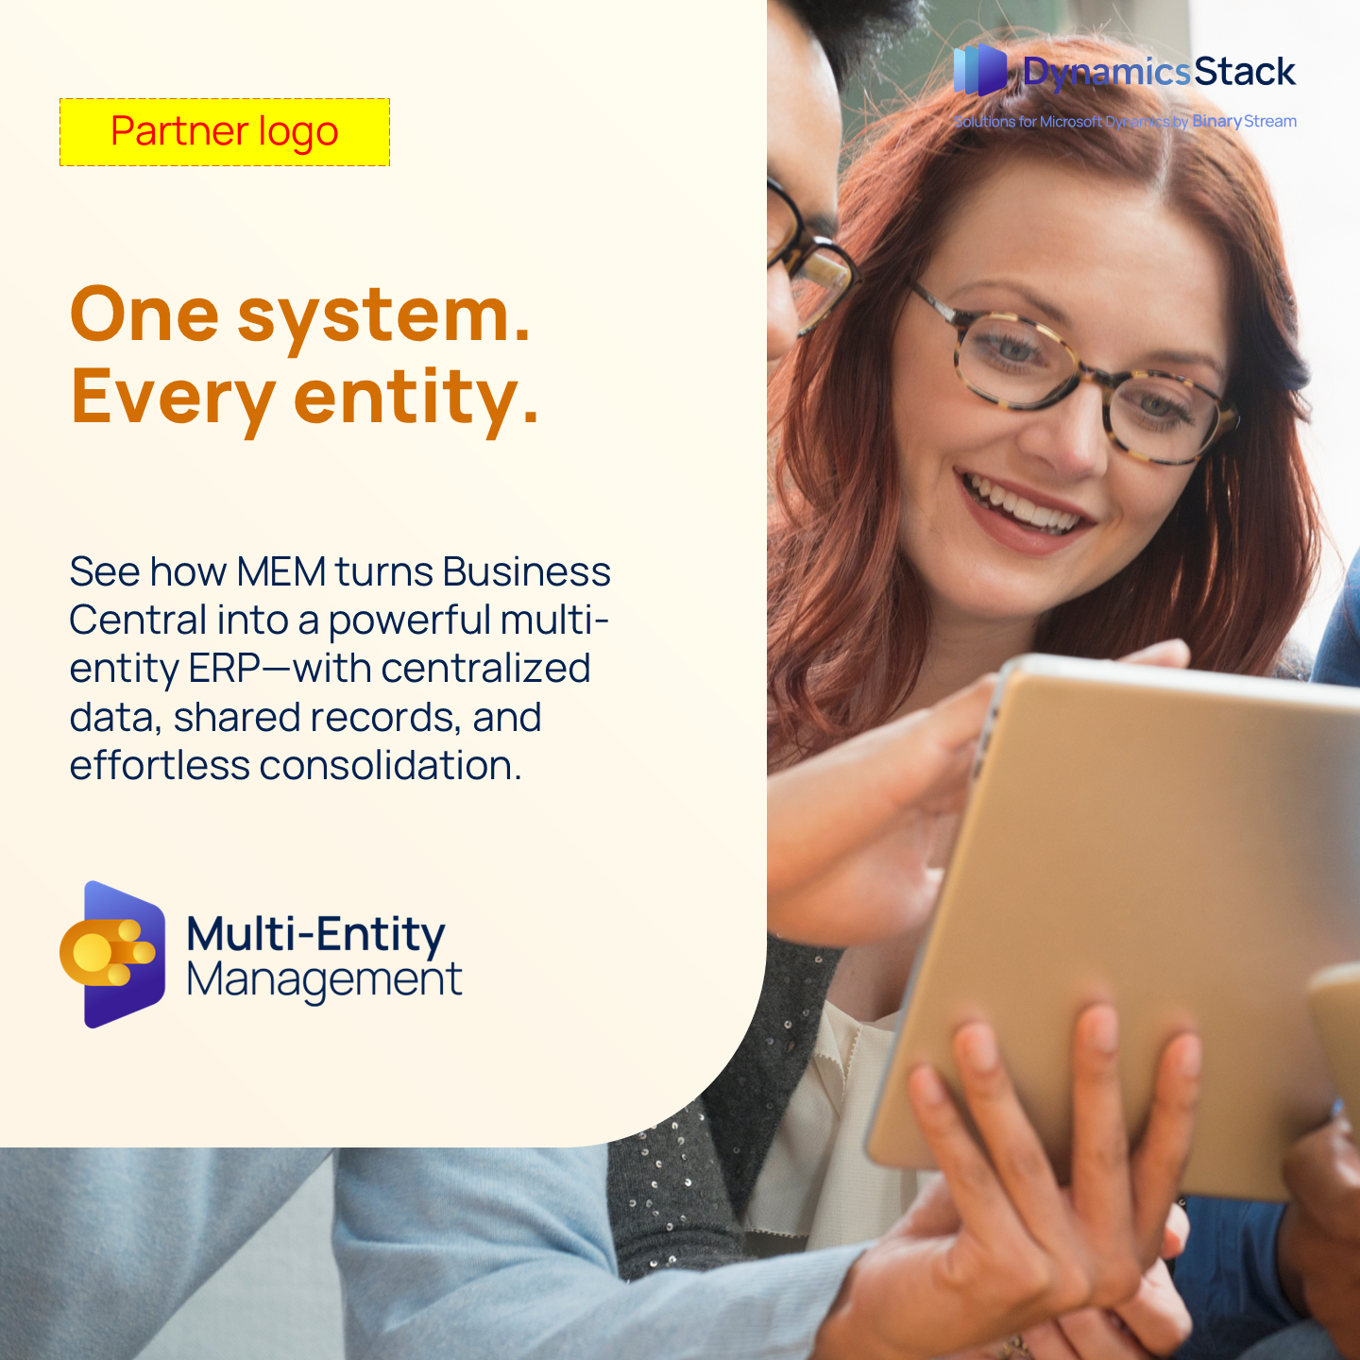
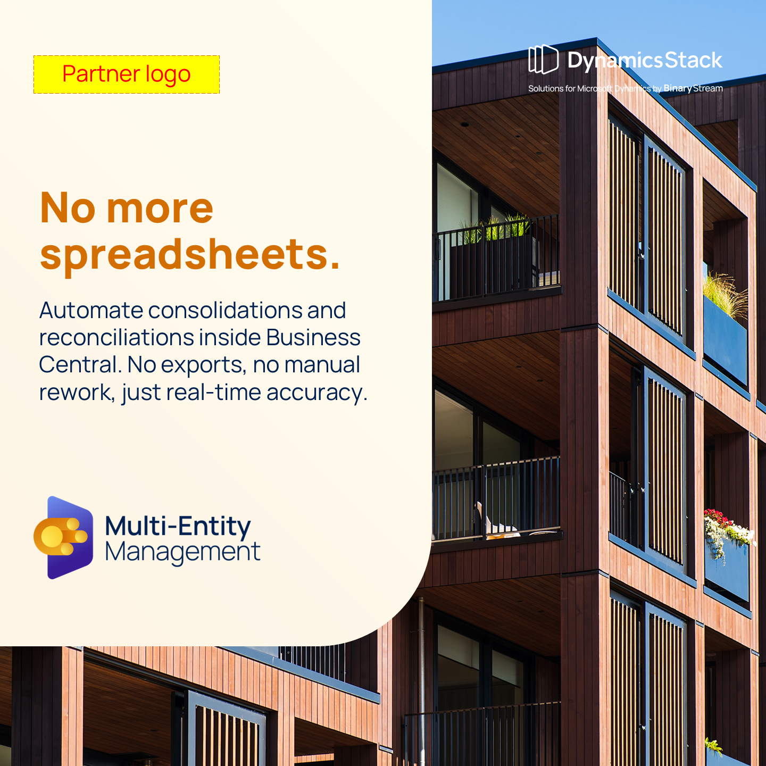
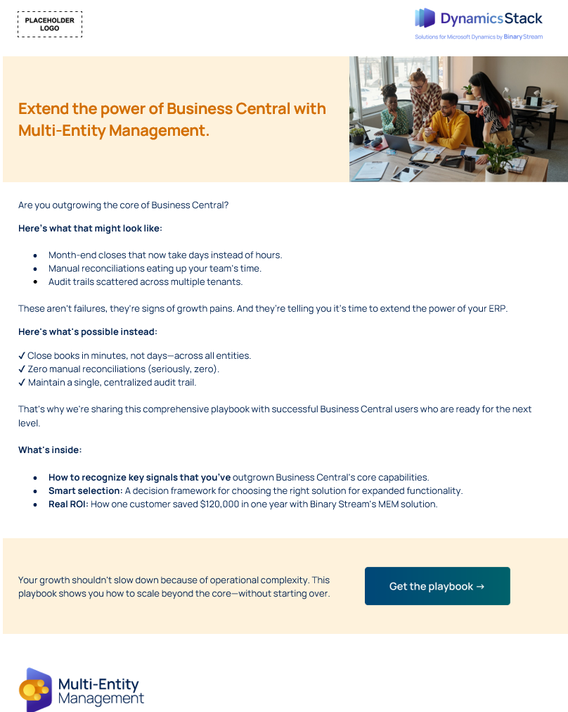
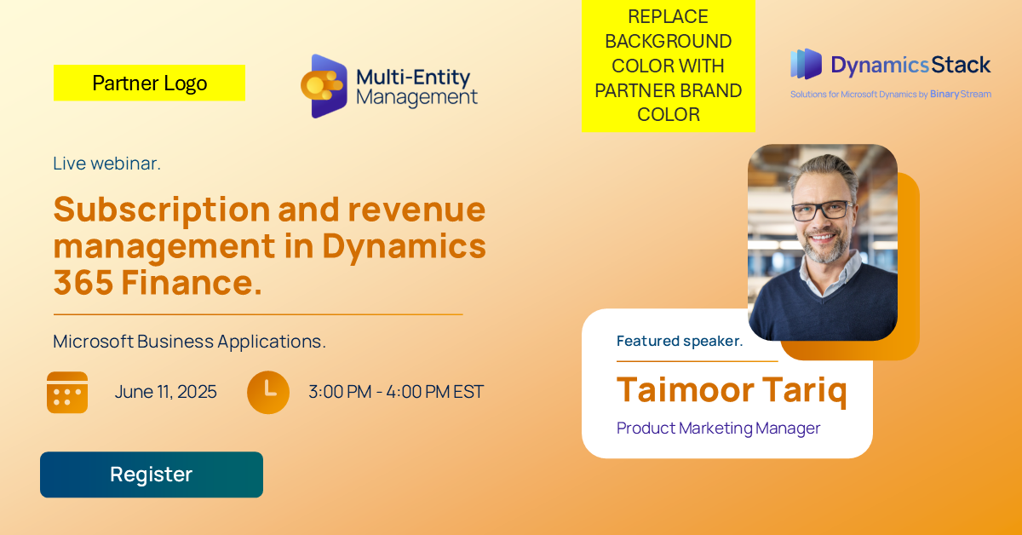
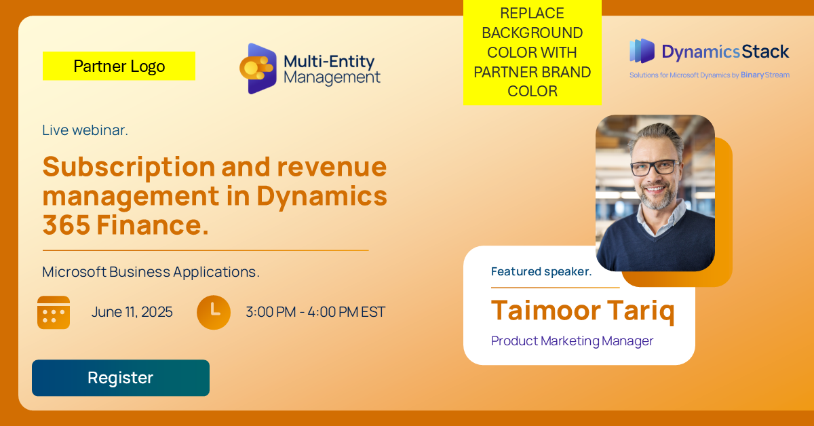
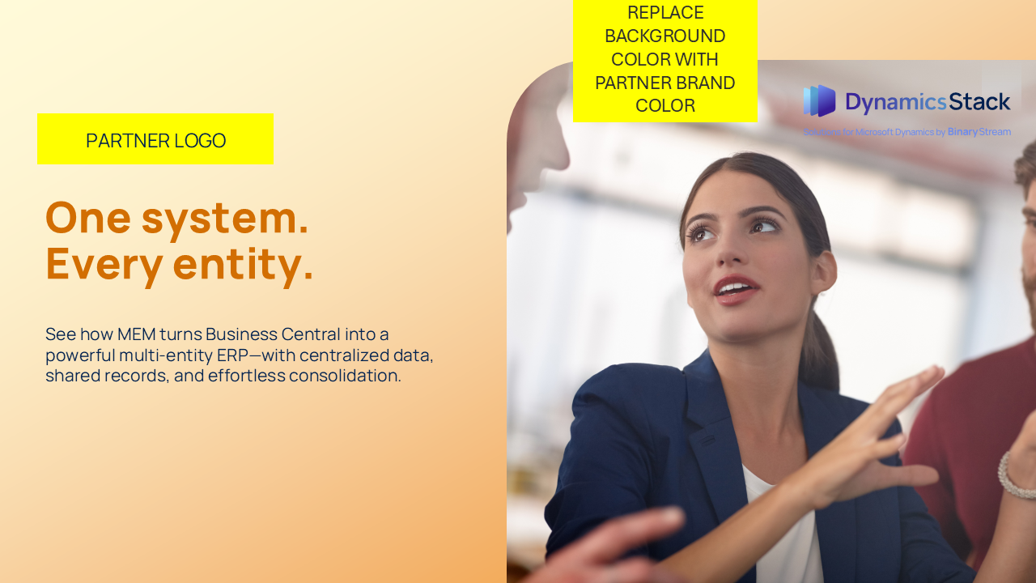
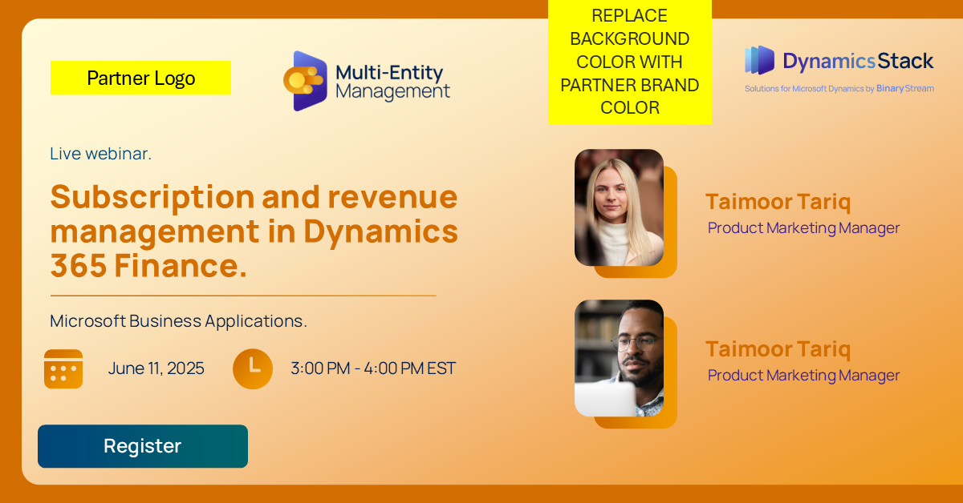

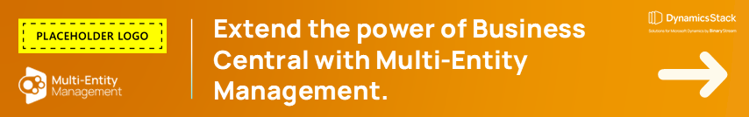
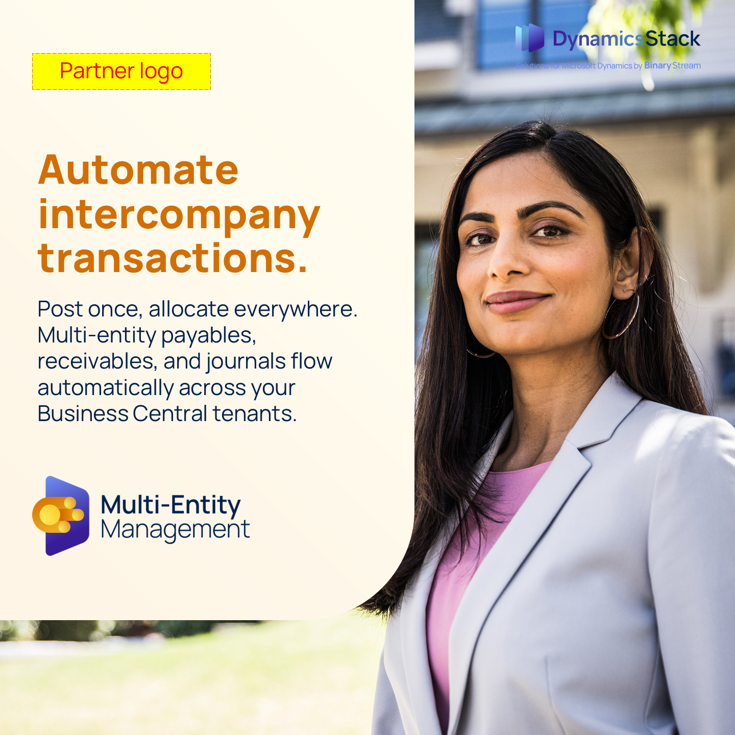
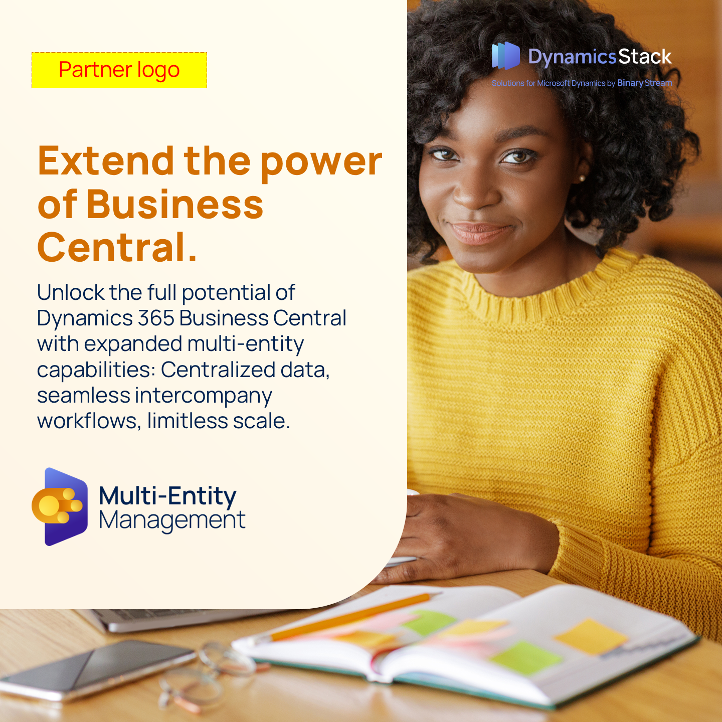
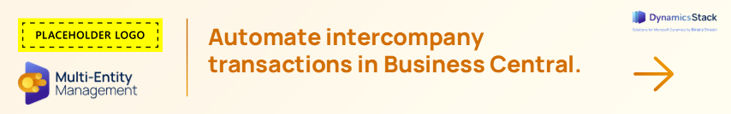

Campaign asset library.
Customizing your assets
The assets in this campaign require you to customize them. You will find placeholder logos that you can replace with your own. You can also modify font, colors, and copy.
You will find customization tips on page 9 of this guide. Each asset also contains specific instructions on how to best customize it.
Ready to start building your pipeline?
Check out the full range of assets on our Campaign Center.
Get support in our Partner Hub.

Slide 7
Demand generation journey.
Use this 4-stage campaignjourney to guide your rollout. Each stage is mapped to specific assets that help move prospects from awareness to action.
Microsoft Fabric
Stage 1: Awareness.
Stage 2: Engagement.
Stage 3: Consideration.
Stage 4: Conversion.
Introduce the concept of going beyond Business Central’s core features.
Promo email: Send to existing contacts directly with the hero asset (ebook) to generate interest and establish credibility.
Social ads: Use paid or organic social ads to drive traffic to the gated landing page with the ebook. Use the gated landing page to capture lead info.
Share more assets and information to encourage consideration. Highlight common challenges and key benefits of extending BC functionality.
Nurture email #1: Is your finance team outgrowing Business Central?
Send to leads and engaged contacts to highlight common challenges and key benefits of extending BC functionality.
Provide real-world validation.
Nurture email #2: How one organization streamlined intercompany accounting by 60%.
Share the case study as social proof and to demonstrate ROI
Encourage direct contact or next-step conversations.
Tip for partners: Pace the journey across 2–4 weeks, using soft touchpoints (social + ads) between emails. Retarget and nurture users who engage with gated content using follow-up emails.

Slide 8





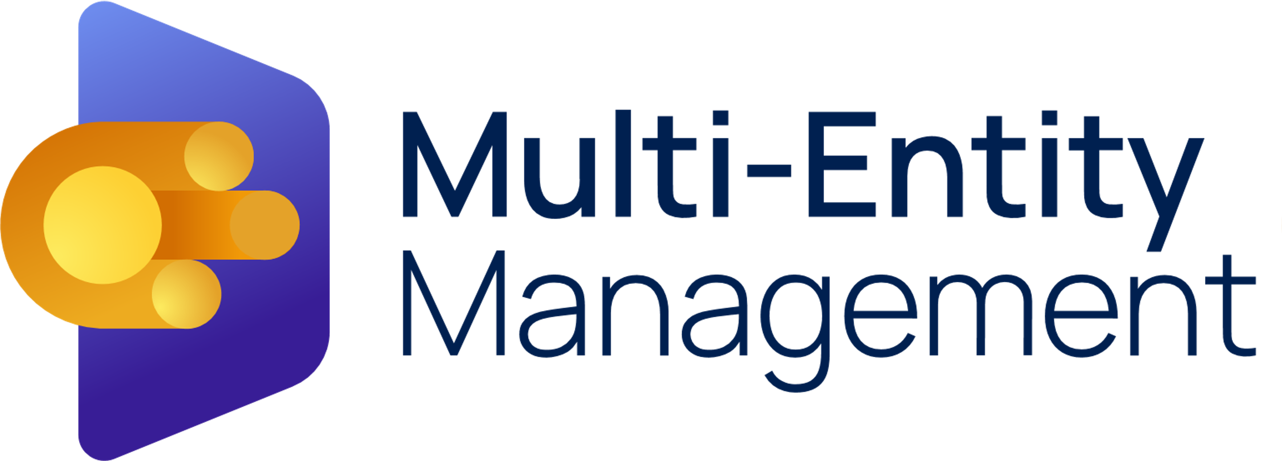

Binary stream logo library.
Download here
Download here
Download here
Download here
Download here
Download here
Download here
Download here

Slide 9
Brand identity – colours and typography.
MEM brand specific palette.
Ochre RGB HEX CMYK 210, 110, 2 #D26E02 14, 66, 100, 2 | Margold RGB HEX CMYK 240, 153, 8 #F09908 46, 100, 0 | Daffodi RGB HEX CMYK 253, 235, 95 #FDEB5F 3, 2, 76, 0
MARIGOLD Multi Entity Mangement Background (15% Opacity) OCHRE
MARIGOLD Accents DAFFODIL | MARIGOLD Accents / Dark Backgrounds OCHRE
Download font here - Manrope

Slide 10
Customization tips.
This campaign is built to be flexible. You can customize most assets with your branding, messaging, and contact information before launching. Here's how to make the most of it:
Branding visual assets.
Update colors, logos, and headers on editable files like the PowerPoint ebook and landing page template.
Replace the placeholder logo with your own on: Ebook, emails, case study, social ads, web banners, etc.
Each asset contains customization instructions and tips.
Customizing copy.
Email templates: Adjust the tone, greeting, or CTA to align with your voice or intended audience market.
Landing page: Use your preferred headline or change the lead capture form based on your CRM or marketing platform.
Using the ebook and case study
Open the provided PowerPoint file.
Add your logo, colors, and contact info to specified sections.
Export as PDF and use it as your gated asset or send directly to qualified leads.
Helpful reminders.
Keep messaging consistent with the campaign’s value proposition: Business Central is great—but sometimes you need more.
When in doubt, less is more. Don’t overcrowd visuals or over-edit CTA copy.

Slide 11
Execution checklist.
Prepare.
Review the full campaign assets and execution guide.
Align campaign goals with your sales and marketing teams.
Identify key audience segments (existing clients, net-new leads, etc.).
Customize assets.
Add your branding to the ebook, case study, social ads, emails, etc.
Customize the landing page with your logo, colors, and form.
Update email copy and CTAs to reflect your voice and offer.
Export the ebook as a branded PDF and gate it behind a landing page.
Launch the campaign.
Post social ads and organic content across your channels to drive traffic to the landing page.
Send Email #1 to existing contacts to generate interest.
Send Nurture email #1 as a follow-up.
Share the case study and Nurture email #2 to drive consideration.
Invite qualified leads to book a discovery call or request a demo.
Track & follow up.
Monitor form submissions, opens, clicks, and downloads.
Share results with your internal team.
Follow up with engaged leads via email or outbound outreach.
Report back on wins and learnings to your Binary Stream contact.

Slide 12

Thank you!

