Slide 1

Dynamic solutions for Microsoft ERP customers.
We help businesses using Microsoft ERP solve complex financial and operational challenges.

Slide 2




Subscription Billing.
Dynamics 365
Business Central

Slide 3

Key characteristics of subscription economy.
Recurring Revenue model.
Payment portal experience.
Continuous
value delivery.
Customer centric focus.
Relying on customer payments and predictable recurring revenue .
Addressing customer churn with seamless payments.
Provide ongoing value to consumers with regular updates and new features.
Focus on customer engagement and satisfaction

Slide 4




Key Needs Driving Subscriptions Management​.
Personalized Customer Engagement.
Efficient Cash Flow Management.
86%
of customers are more likely to renew their subscriptions if they receive tailored, timely communications .
75%
of businesses cited late payments as a significant issue​.
Frictionless Payments.
Data-Driven Decision Making.
72%
76%
of subscribers prefer managing payments through a portal, reducing payment friction​.
76% of CFOs are prioritizing real-time reporting to drive financial decisions​.

Slide 5
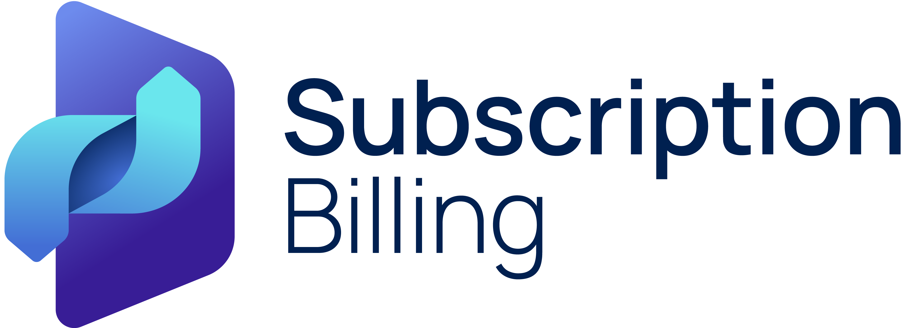

Subscription Billing updates.
+
Dynamics 365 Business Central
Oct 24
Oct 24
Nov 24
Jan 25
June 25
 | Microsoft releases basic subscription billing capabilities in Business Central |  | Binary Stream releases enhanced Subscription Billing Suite Bundle | Binary Stream releases integration with Solver for advanced reporting as part of SBS bundle | Binary Stream releases Microsoft Cloud Service Provider (CSP) integration with SBS |  | Binary Stream releases Portal solution for Subscription Billing Suite

Slide 6






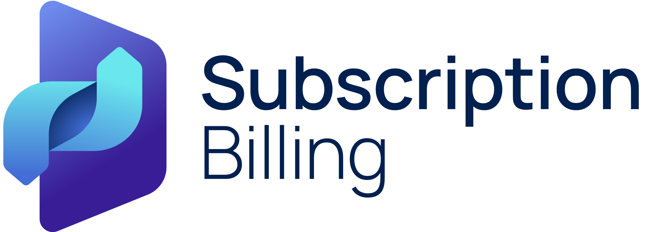
Subscription billing lifecycle.
Enter a contract with a customer.
Determine billing intervals.
Create invoices as per billing cycle.
Modify contract as needed.
Automatically renew contract.
Evaluate performance.
Externally (CRM)
Internally through SBS
One-time billing
Recurring billing
Milestone billing
And more
Specific date
End-of-month
X days before Start Date.
Upsell
Downgrade
Termination
Add another term
Continue on a month-to-month basis
Leverage the built-in reports: MRR, New Sales, Upcoming Renewals

Slide 7
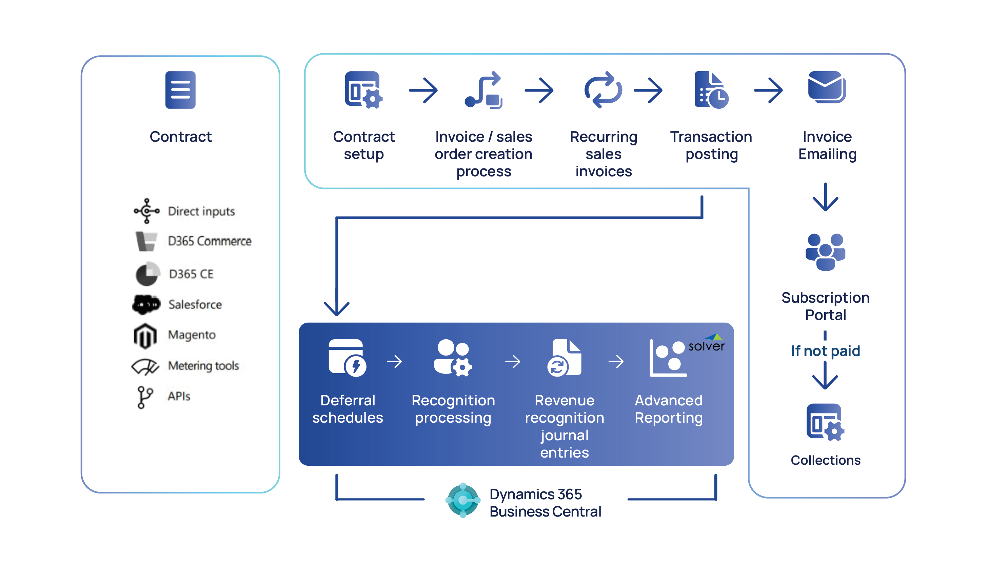
Order to Cash Process.

Slide 8




Complete Order to Cash Solution.
Your business isn’t siloed, and neither should your billing be. With Binary Stream’s SBS Bundle, you get an end-to-end solution, from seamless billing to receivables, collections, customer communication, payments, and financial planning.
Subscription Billing
AR & Collections
eMailer Manager
Portal
Solver Reports
Streamline your subscription processes
and manage complex sales orders, handle contracts and automate subscription billing while streamlining revenue recognition functions.
Improve cash flow and minimize Days Sales Outstanding (DSO) with our powerful AR & Collections tool. It’s not just about getting paid—it’s about getting paid faster and more efficiently.
Automate your customer communications with tailored messaging that engages customers at every stage of the billing cycle, ensuring clarity and satisfaction.
Facilitate payment processes with a dedicated self-serve portal designed for customers to manage their subscriptions, view invoices, and make payments.
Gain deep insights into your revenue KPIs with advanced dashboards and reporting. With Solver at your fingertips, you’re not just reacting to financial data—you’re strategically driving your business forward.

Slide 9

Streamline Revenue Management with Subscription Billing Suite.
Binary Stream’s Subscription Billing Suite (SBS) Bundle integrates billing, receivables, collections, customer communication, payments, and financial reporting into a seamless solution. Designed to simplify processes and enhance efficiency, SBS empowers businesses to drive growth and streamline financial operations.
Embedded in Microsoft Dynamics 365 Business Central, SBS automates the order-to-cash process—from managing sales orders and contracts to streamlining revenue recognition—while ensuring compliance with ASC 606 and IFRS 15 standards.

Slide 10

Subscription Billing Suite.
Advanced Reporting with
Solver Integration
Subscription Billing Suite
AR & Collections
eMailer Management
Portal

Slide 11
Subscription Billing Suite Bundle for D365 Business Central.
Your business isn’t siloed, and neither should your billing be. With Binary Stream’s SBS Bundle, you get an end-to-end solution, from seamless billing to receivables, collections, customer communication, payments, and financial planning.
Subscription Billing
AR & Collections
eMailer Manager
Portal
Solver Reports
Streamline your subscription processes
and manage complex sales orders, handle contracts and automate subscription billing while streamlining revenue recognition functions.
Improve cash flow and minimize Days Sales Outstanding (DSO) with our powerful AR & Collections tool. It’s not just about getting paid—it’s about getting paid faster and more efficiently.
Automate your customer communications with tailored messaging that engages customers at every stage of the billing cycle, ensuring clarity and satisfaction.
Facilitate payment processes with a dedicated self-serve portal designed for customers to manage their subscriptions, view invoices, and make payments.
Gain deep insights into your revenue KPIs with advanced dashboards and reporting. With Solver at your fingertips, you’re not just reacting to financial data—you’re strategically driving your business forward.

Slide 12

Subscription Billing Suite modules.
Advanced Revenue and Expense Deferrals (ARED)
Advanced Recurring Contract Billing (ARCB)
Multi-Element Revenue Allocation (MERA)
Line level deferrals: straight line and event-based
Reports – deferral balance, waterfall, declining balance
Complex billing management: usage-based, milestone, and revenue split.
Robust pricing models: flat, tiered, and price increases & discounts.
Flexible invoicing intervals with automatic renewals.
Real-time reporting & forecasting for monthly recurring revenue and renewals.
Assist with revenue compliance for multi-performance obligation contracts (IFRS 15 & ASC 606.
Revenue re-allocation.
Calculate and set up revenue-split contracts.

Slide 13
Portal Plan Features
Portal
Feature
Essential | Allow customers to make payments with the support of multiple gateways. Provide flexible payment options including credit cards, bank transfers, and wallets. Fully white-labeled to reflect your brand and strengthen trust.
Premium | Essential + Premium & SBS capabilities: SBS Self-serve portal integration with SBS on BC Allow customers to update subscription contracts with or without approval
Premium for Partners | Premium plus the following: CSP Product Catalog Integration Customer Management Allow direct purchase and update of CSP products Payment Reconciliation (Vendor and Customer)

Slide 14
Embedded vs Standalone Subscription Solutions.
Use case.

Slide 15
Latest Microsoft Business Central Release.
Microsoft introduces basic subscription billing capabilities in Business Central’s core offering.
Why?
Core Business Central lacked subscription billing, limiting Microsoft partners' ability to compete with solutions like NetSuite.
The Opportunity:
Microsoft partners can serve their clients with Core Business Central Subscription
Enhance the offering with Binary Stream’s Advanced Subscription capabilities
Binary Stream’s enhanced Subscription Billing Suite Bundle (SBS).
A powerful, all-in-one industry specific solution designed to take subscription billing beyond the basics and provide an unparalleled, end-to-end order to cash experience.

Slide 16





Subscription Features Added to BC.
Management of Service Commitments.
Invoice Preview using Billing Templates.
​Automatic Straight-line Deferrals.
Usage Billing.

Slide 17
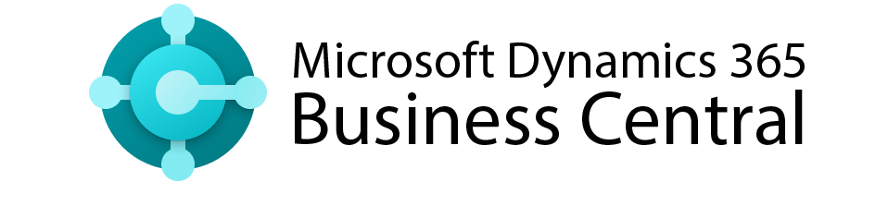
Comparing Core Business Central with Binary Stream Solutions.
Service Subscription Management | Service Subscription Management + Stock Item Subscription, Complex Contract Management
Revenue Management | Revenue Management + Long & Short-term Deferral for Revenue, COGS and Discount, ASC 606 & IFRS15 Compliance
Price Management | Price Management + Escalations, Promotions, Discounts and CPI Increases
Automatic Renewal | Automatic Renewal + Evergreen Contracts, Renewal Levels & Renewal Reports
Usage Billing | Usage Billing + Tier-Pricing Support, Consumption Commitments & Billing Limits
Invoicing | Invoicing + Batch Invoicing, Milestone Billing and Invoice Consolidation

Slide 18


SBS vs Business Central Core Subscription.
End-to-end SBS Bundle – Billing, collections, payment processing & Reporting
Portal – Self-serve to manage subscriptions, view invoices, and make payments
Integrations – With Microsoft CSP Portal, third-party products and CRM
Compliance – ASC 606 & IFRS 15 compliance for bundled products, revenue allocation
Reporting – MRR, Renewals, Churn, Profit Margin, Solver Reports
Advanced Recurring Billing & Revenue Recognition – Handle various billing needs, fully compliant with ASC606 and IFRS15

Slide 19
Contract Creation.
Feature.
Create Contracts from a Sales Order.
Create Contracts from a CRM.
Start a Contract upon item Shipment.
Sales Contracts.
Purchase Contracts.

Slide 20
Contract Management.
Feature.
Renewals.
Termination.
Align to start/end date of the month.
Align to any other day of a month.
Change quantity of a contract item in middle of the period.
Calendar billing.

Slide 21
Price Management.
Feature.
Support item pricing.
Price escalation.
Billing period discount.
Update contract prices.
Minimum & Maximum price or quantity .

Slide 22
Invoicing.
Feature.
Mass invoice creation.
Invoice consolidation (Bill-to, ship-to, Items, end users).
Bundle items.
Milestone billing.

Slide 23
Revenue Deferral.
Feature.
Defer and recognize revenue of a stock item
Adjust deferral schedule.
Event-based deferral.
Unbilled revenue.
Performance obligations identified under ASC 606 and IFRS 15 standards

Slide 24
Usage billing.
Feature.
Upload usage.
Upload meter reading.
Tier-pricing.
Consumption commitments.
Billing limits.

Slide 25
Self-serve Portal.
Feature.
Allow customers to review their contracts from a portal.
Allow customers to pay outstanding invoices.
Allow customers to review payment history.
Pre-authorized payments automation (Stripe, Go Cardless).
Ability to update contracts including approval workflow.
Support sale through the CSP partner channel and update the Microsoft partner center.

Slide 26
Integrations.
Feature.
Create contract from CRM or 3rd party products via APIs.
Update contracts from CRM or 3rd party products via APIs.
Upload contract usage via APIs
Terminate contracts from a CRM or 3rd party via APIs.
Terminate contracts via APIs and create credit memos.

Slide 27
Reporting.
Feature.
Report on a bill-to and sell-to customer (partner / end user).
Report on contract revenue (MRR, Profit Margin and more).
Report on upcoming events (renewals, churn and more).
Report on deferred and recognized revenue .
Support audit trail functionality for contract/deferral change.
Custom reports powered by Solver

Slide 28
Case Study Example (Service Industry).
Situation:
Scenario:
Device Shipment & Subscription Initiation: Upon purchase, GPS devices are shipped, and a 3-year service contract begins. Each device has a unique serial number, which is included in the contract and invoice.
Revenue & Cost Accounting: Revenue is recognized monthly, and the $900 device cost is amortized over 36 months, with $25/month recorded as COGS to match the ongoing service revenue.
Return Merchandise Authorization Process: If a contract is canceled or not renewed, the customer can initiate an RMA. The serial number tracks returns, updates the contract, and adjusts the deferral schedule. Journal entries adjust the costs based on the initial shipment and amortization.
XYZ Systems, a fleet management company, provides GPS tracking devices and related services to businesses with large vehicle fleets. Their products help customers optimize operations through real-time tracking, data analytics, and maintenance management. XYZ sells GPS devices alongside service contracts that include ongoing subscriptions, amortizing device costs over the contract's lifetime. They ship devices and activate service contracts immediately, requiring precise financial tracking to ensure profitability and customer satisfaction.
Features Not Supported by CORE BC.
Automatic Billing
Contract Creation.
Cost Tracking.
Deferrals Method.
Equipment Management.
Sales Order.
Sales Invoice.
From CRM.
Amortize cost of device using COGS deferrals.
Deferral of inventory
Separate deferral amount in Short-term and Long-term to stay compliant with GAAP, IFRS 15 and ASC 606.
Balance Sheet and Profit & Loss.
Serialized Tracking.
Equipment Return RMA Process.
Cost Amortization.

Slide 29
Case Study Example (Software & Tech Industry).
Situation:
Scenario:
Contract Creation: ABC Software Solutions generates subscription contracts via CRM, including milestone payments for implementation and ongoing support terms.
Prepayment: Upon signing, the customer is billed 50% of the project cost as a retainer.
Installation Milestone: After installation, a 25% invoice is generated.
UAT Completion: Upon UAT approval, the final 25% invoice is issued, transitioning the project to the subscription phase.
Subscription Activation: Monthly recurring billing begins for ongoing updates and support.
Customer Portal: Clients manage billing and subscriptions through a self-serve portal.
ABC Software Solutions is a project-based company that sells customized software solutions and their implementation services to other businesses. These services include the initial software deployment, integration with the client’s existing systems, and ongoing support through a subscription model. Their revenue is deferred based on the completion of each milestone.
Features Not Supported by CORE BC.
Automatic Billing
Contract Creation.
Milestone Billing.
Deferrals Method.
Subscription Portal.
Sales Order.
Sales Invoice.
From CRM.
Percentage Completion.
Balance sheet or Profit & Loss
Event based deferral and Revenue Recognition (BC has only straight-line)
Move balance between deferral accounts.
Payment Collection.
Payment History.
Contract Update (Hold & Termination).

Slide 30
Case Study Example (Software & Tech Industry).
Situation:
Scenario:
Usage-Based Billing: The photocopiers track the number of copies made and then this usage data is imported to the contract for tracking purpose and accurate billing.
Minimum Commitment: Using the min/max functionality, the contract generate a base invoice for the minimum commitment of 10,000 copies, regardless of whether this quantity is fully utilized.
Overage Billing: If a client exceeds the minimum commitment, the system should calculate the additional charges based on the actual usage up to the cap of 50,000 copies.
Tiered Pricing: Once the cap of 50,000 copies is reached, the contract applies a premium rate for additional copies.
Copyright Solutions offers photocopier leasing services to businesses that require high-volume document copying solutions. Their services include not only the leasing and installation of photocopiers but also ongoing maintenance. The core of their business model is usage-based billing, where clients are charged based on the number of copies made each month. Copyright solutions is capable of creating and customizing contracts that feature specific terms such as minimum commitments, usage-based billing and volume pricing.
Features Not Supported by CORE BC.
Price Management.
Usage Billing.
Minimum Commitment.
Overage Billing.
Tiered Pricing.
Direct upload to contract from Excel CVS files.
Usage billing details in contract.
Edit Consumption in contract.
Invoicing usage items from contract.

Slide 31
Case Study Example (Software & Tech Industry).
Situation:
Scenario:
Promotional Period: ServiceX offers 3 months of free support for clients with a 2-year prepaid contract, deferring revenue.
Revenue & Discount Deferral: Revenue and discounts are deferred and recognized monthly over the contract's duration, ensuring GAAP compliance.
Automatic Renewal: Contracts auto-renew before expiration, based on the customer's renewal level.
Contract Health Tracking: ServiceX uses reports to monitor renewals and revenue, including the Contract Renewal Summary and Revenue Waterfall reports.
ServiceX Solutions offers a range of subscription-based IT support services essential for businesses. Their business model emphasizes long-term contracts with built-in pricing flexibility designed to ensure customer retention and predictable revenue growth. By offering service maintenance packages – Unlimited (40%), Gold (25%),, Silver (20%), and Bronze (15%) – ServiceX Solutions caters to a wide range of business sizes and needs. Each package comes with the option for a promotional period.
Features Not Supported by CORE BC.
Price Management.
Subscription Management.
Deferrals Method.
Reports.
Tier Pricing.
Free Quantity.
Promotional Periods.
Support and Renewal.
Separate deferral amount in Revenue and Discount Deferral amount.
Deferral Schedules.
Revenue Recognition (BC has straight-line only).
Move balance between deferral accounts.
Upcoming contract renewal report.
Deferral Balance report.
Revenue Waterfall report.

Slide 32
Efficiency.
Case Study Example.
Centralized transaction management.
Real-time consolidated reporting.
Scalable security and permissions control.
Situation:
FleetMovers Inc. provides GPS tracking services to businesses with large vehicle fleets, offering subscription-based service contracts for their GPS tracking devices, which include software updates, maintenance, and support.
Cost-Effectiveness.
No extra charges for integration, unlike standalone solution
Challenges:
Manual reconciliation of contract revenue led to errors and inefficiencies.
Lack of multi-language and multi-currency support hindered global expansion.
Global Expansion.
Multi-language and multi-currency support enabled rapid global growth.
Solution:
Implemented Subscription Billing solution integrated with Microsoft Dynamics 365.
Offered multi-language and multi-currency support with no extra cost.
Advanced Technology.
Leveraged Microsoft AI and security features

Slide 33





Situation:
Northern BI’s accounting software was insufficient for managing ongoing subscriptions and renewals, requiring manual reconciliations and leading to time-consuming errors.
Northern BI reduces billing workload by 50% with migration to Dynamics 365 Business Central.
Solution:
Northern BI adopted Binary Stream’s Subscription Billing Suite (SBS) and transitioned to Microsoft Dynamics 365 Business Central.
Benefits:
Greater accuracy, improved scalability, and time and effort saved through automation.
“We wanted to continue to use Subscription Billing Suite in our migration from Dynamics GP to Dynamics 365 Business Central. For us, it was a great and natural transition because we had already learned the functionality within the old environment and could move seamlessly into the new environment.”
50%
100%
98%
less time spent on recurring billing cycles.
scalability as
expansion
accelerates.
embedded
within GP
and D365 BC.
migration from
on-premise to
cloud-based.
customer
retention.
advanced
security features.
Read the story here
Brian Mackintosh, VP of Operations at Northern Business Intelligence

Slide 34

Situation:
Sunshine 811 saves 15,000 annually by streamlining recurring billing with Subscription Billing Suite.
Sunshine 811 struggled to manage billing processes for over 1000 members, resulting in limited visibility, unreliable data, and time-consuming processes.
Solution:
A consultant partnered with Sunshine 811 to identify Binary Stream’s Subscription Billing Suite (SBS) as an innovative solution that fit their needs.
Benefits:
Greater flexibility, improved transparency, and time and effort saved by automating processes.
2+
6+
100%
$12,000-$15,000
1,000+
“It makes things efficient for us because it’s one upload that we have to do. We can set it and forget it for almost a year. The system manages itself.
It’s flawlessly integrated.”
weeks saved each month.
months saved per year.
integration with Business Central.
members accurately billed.
annual savings.
Read the story here
Julie Adamson, Accounting Manager and Controller at Sunshine 811

Slide 35

Situation:
BT Conferencing effortlessly manages over 10,000 deferral accounts with Subscription Billing Suite.
With a growing base of over 10,000 deferral accounts, BT Conferencing had to meet strict compliance regulations while facing rigorous accounting standards.
Solution:
BT Conferencing worked with Binary Stream to fully implement Subscription Billing Suite (SBS) for automating their deferrals and reporting.
Benefits:
Greater financial reporting accuracy, improved forecasting, and higher productivity through automation.
2+
25-35
10,000+
10%
“For a public company like BT, it is of great importance to know how much money they have in the bank now and in years to come.”
months saved
on labour-intensive processes each year.
million dollars per year
deferred without complication.
deferral accounts
managed with ease each month.
of one full-time employee’s workload
is all that’s required to manage deferrals
effectively.
Read the story here
Paul Fortson, BT Conferencing Director of Financial Systems

Slide 36

Situation:
QTS was operating 33 separate Microsoft Dynamics databases, resulting in productivity bottlenecks, misaligned systems, and difficulty with revenue recognition and deferrals.
QTS save over
11 days on end-of-month close cycles with Binary Stream.
Solution:
QTS selected Binary Stream, which combined the power of Multi-Entity Management (MEM) and Subscription Billing Suite (SBS) to meet the customer’s complex needs.
Benefits:
Centralized accounts processes, a streamlined database, and time and effort saved through automation across entities.
12+
1
30 %
11 days
new data centers
opened since implementation.
centralized environment
to better manage financial consolidation.
decrease in redundant processes
through automation across all entities.
time saved per month
on the previous month-end close cycle.
“We can now create a single purchase requisition and
distribute the GL coding amongst multiple facilities.”
Kitty Geige, Sr. Dynamics System Administrator at QTS
Read the story here

Slide 37

Situation:
With over 340,000 active users, monthly payments processing became impossible for MoxiWorks, requiring cumbersome workflows, and resulting in errors.
MoxiWorks
saves 80 days annually by
automating recurring billing processes.
Solution:
A trusted implementation partner as user feedback helped MoxiWorks identify Binary Stream’s Subscription Billing Suite (SBS) as an innovative software solution to address their challenges.
Benefits:
Reduced processing time, increased access to insights, and streamlined revenue and expense recognition.
80%
260+
15days
80 days
“Wonderful, wonderful, wonderful. A joy to work with Binary Stream. Everyone was super helpful and positive, which had a big impact on the success of the implementation.”
less time spent on manual tasks.
brokerages served.
saved per year preparing taxes.
saved per year.
Read the story here
Dean Tibbetts, Controller, MoxiWorks

Slide 38

Situation:
Using 3 different systems meant that OTC had to rely on manual systems, resulting in limited access, lost time, and regular errors.
OTC saves 80 days per month on
financial statements with Binary Stream.
Solution:
OTC identified Binary Stream’s Subscription Billing Suite as an innovative solution to solve their challenges while seamlessly integrating with Microsoft Dynamics.
Benefits:
Greater access to real-time data, elimination of errors, and time and effort saved.
0 data entry errors
50% less time spent
7 days of reporting
120+ hours
“When we do field a customer billing inquiry, we are able to more easily track down and resolve the error at the source point and correct it.”
on average per month.
on month-end financial statements.
saved per month.
per month saved.
Read the story here
Tim Ryan, Managing Director, Head of Sales
at OTC Markets

Slide 39

Binary SBS vs Chargebee.
Competitive Analysis.

Slide 40
Competitive Analysis Chargebee.
Top 3 Advantages of Chargebee.
Excels in complex subscription models, recurring billing, one-time charges, and usage-based pricing. Advanced revenue recognition, suitable for SaaS, education, and e-commerce businesses.
Supports wide variety of payment gateways, credit cards, ACH, and international payment for global operations.
Customer self-serve portal to manage subscriptions, billing, and invoices without involving customer support.
How does Binary Stream Compete.
Microsoft Integration.
Lower Cost of Ownership.
Advanced Solver Reporting.
Chargebee lacks direct integration with Business Central & Microsoft CSP Portal whereas SBS is embedded within BC. This provides seamless, end-to-end management of the entire order-to-cash process, eliminating the need for system reconciliation, removing data silos, ensuring centralized data within BC, a unified user interface, and reducing security and compliance risk.
Chargeebee has steeper learning curve and requires more time to configure. Pricing starts at $599/month, and additional charge for ERP integration, invoice consolidation, manual discounts, report builder, contract terms and more than 3 currencies. Whereas SBS offers more cost effective and scalable pricing.
Both solutions offer subscription analytics and reporting, but Binary Stream Advanced Reporting module allows detailed financial planning, deeper visibility into subscription revenue and AR performance.

Slide 41

Binary SBS vs Recurly.
Competitive Analysis.

Slide 42
Competitive Analysis (Recurly).
Top 3 Advantages of Recurly.
Recurring billing system for managing different billing frequencies, pricing models, and coupons and free trials.
Wide variety of payment gateways (Stripe, Braintree, PayPal, credit & debit cards, digital wallets).
Integrations with Salesforce, QuickBooks, Xero, HubSpot and more, suitable for companies with complex tech stack.
How does Binary Stream Compete.
Microsoft Integration.
Scalable & Cost Effective.
End-to-end solution.
Unlike Recurly, SBS is embedded within BC, allowing seamless end-to-end management of the entire order-to-cash process. With SBS, there is no need for system reconciliation, ensuring centralized data within Business Central, a consistent user interface, and reduced security and compliance risk
Lower total cost of ownership as Recurly starts at $290 and charges more for language support, ACH, account activity import/export, customer fields, invoice receipt and intelligent retry.
More extensive solution than Recurly, covering subscription billing, AR & Collections management, and Advanced Reporting module for financial planning & analysis.

Slide 43

Business challenge.
We need to streamline and automate our customer billing processes to enhance efficiency and accuracy. Our contracts include usage-based billing, annual price adjustments, and milestone billing.

Slide 44
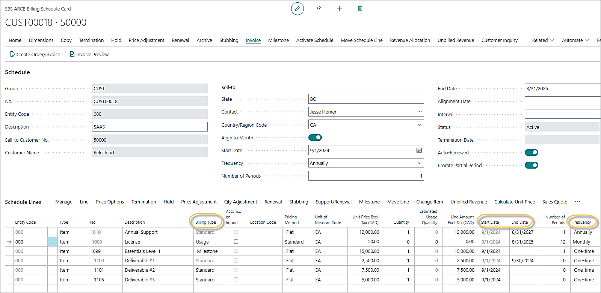
Contract Management.

Slide 45

Business challenge.
In addition to straight line recognition, we need to be able to recognize revenue based on 3 specific deliverable dates. Can SBS handle both scenarios?

Slide 46
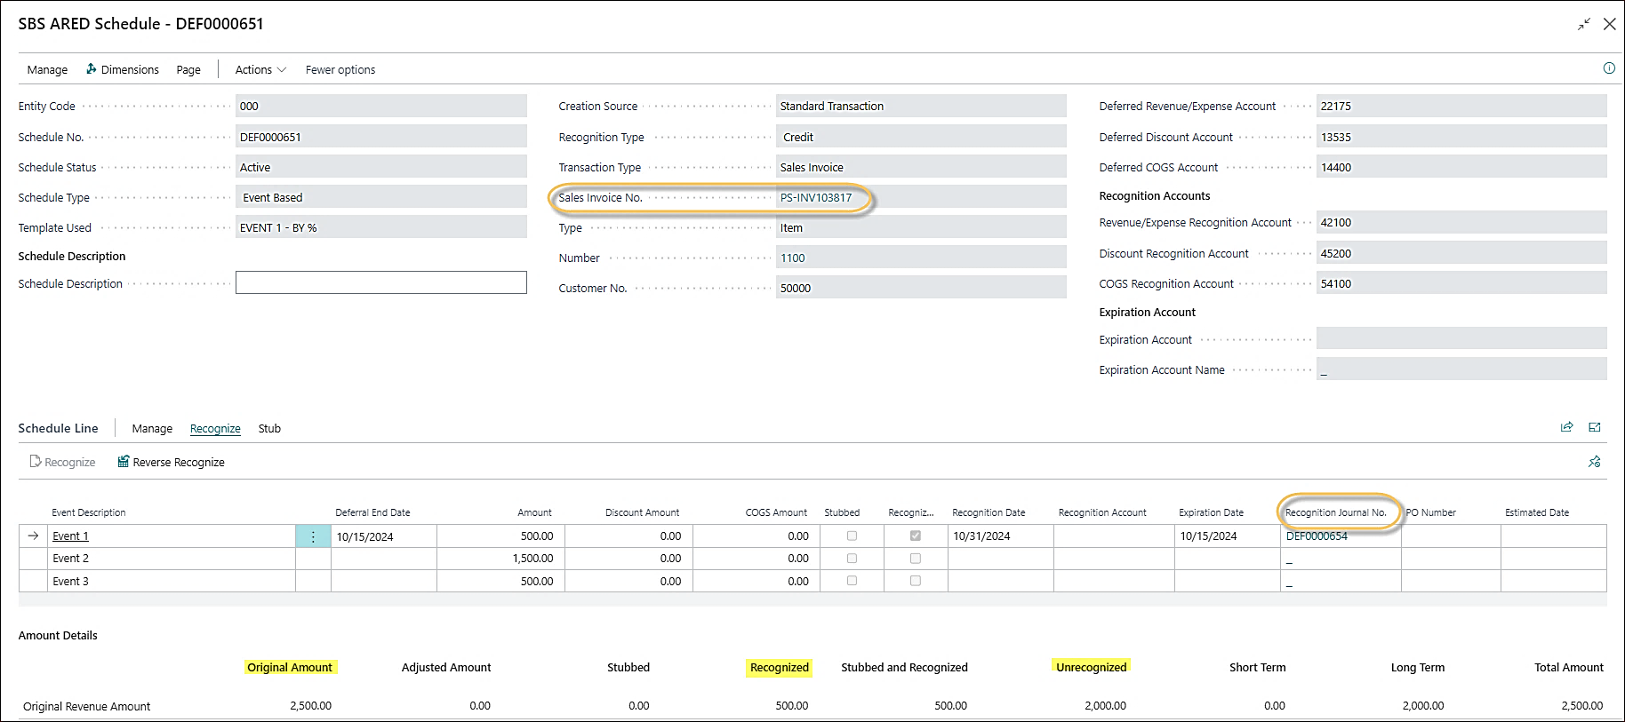
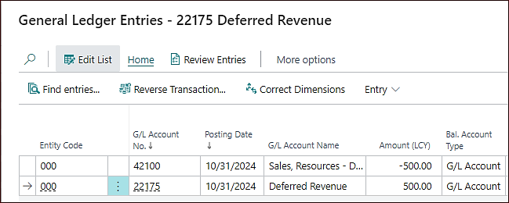
Revenue Recognition.

Slide 47

Business challenge.
Our customers prefer managing their own payments, which would save us time on follow-ups and help them make timely payments. Do you have any options?

Slide 48
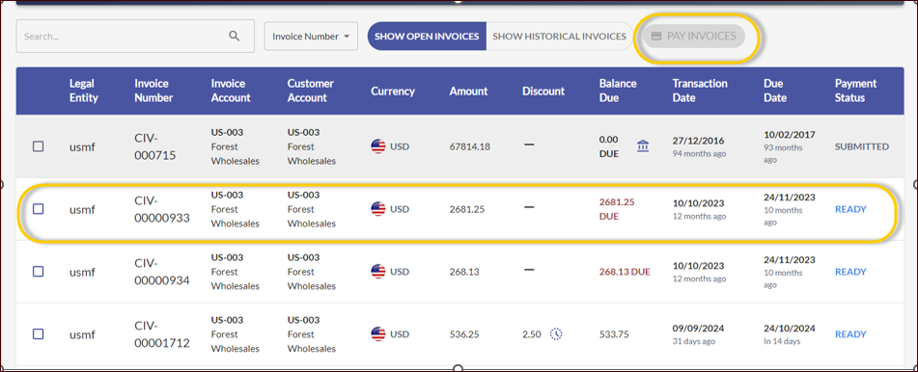
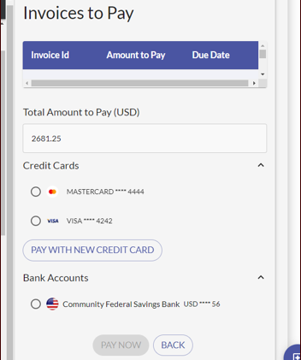
Portal – Payments.

Slide 49

Business challenge.
We need to track and report on a variety of KPIs. Does your solution support MRR, waterfall reports, and other subscription related reporting needs?

Slide 50
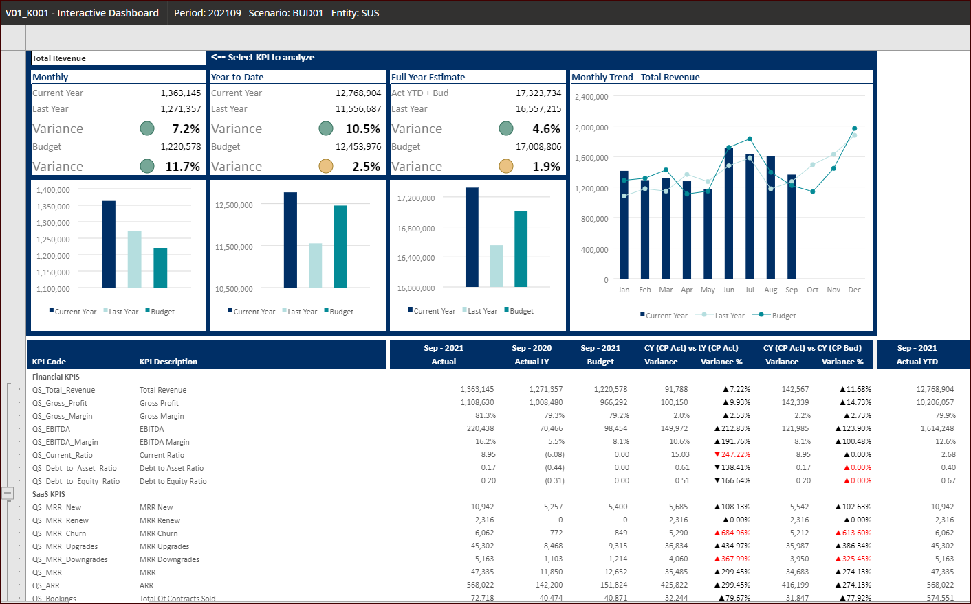
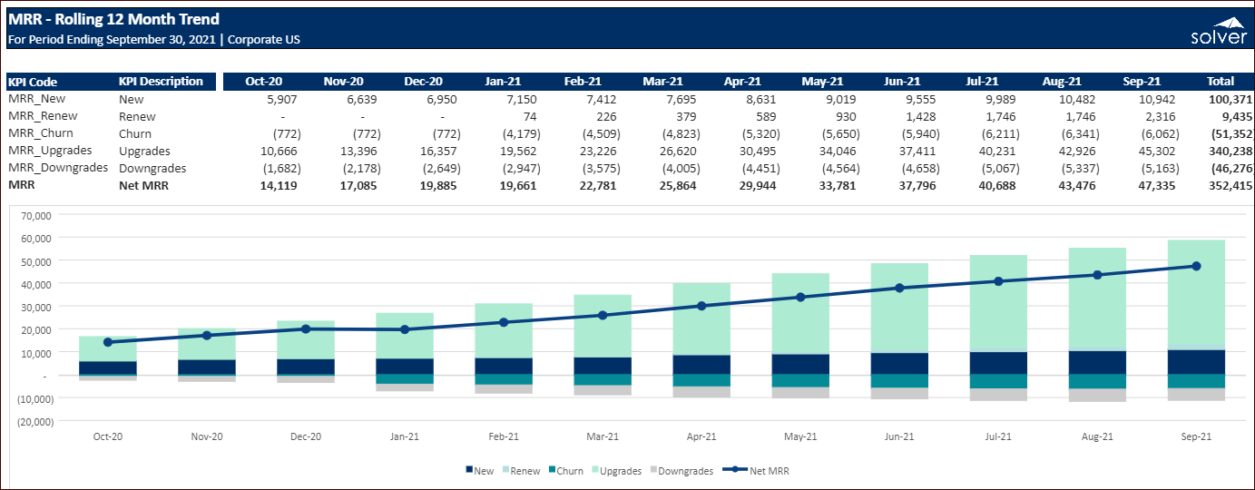
Advanced Reporting.

Slide 51
Real results from real customers.
From automated billing and collections to revenue recognition and real-time reporting, simplify your recurring revenue operations, and streamline your compliance saving you valuable time and money. Don’t just take our word for it, see what our customers have achieved.
$120k
50%
10k
80+
annual cost savings from automating billing & collections.
workload reduction through subscription and payment automation.
revenue deferrals automated in a single implementation.
days saved annually with streamlined order-to-cash workflows.

Slide 52
Wrap Up
Have an amazing start to 2025!
Connect with your account manager or email sales@binarystream.com to continue the conversation.

