Slide 1

Dynamic solutions for Microsoft ERP customers.
We help businesses using Microsoft ERP solve complex financial and operational challenges.

Slide 2


Property & Lease.

Slide 3

Embedded lease management for streamlined compliance and growth.
Property & Lease Management (P&LM) is an embedded solution for Dynamics 365 Business Central, delivering seamless lease accounting and asset management while ensuring compliance with IFRS 16 and ASC 842.
P&LM simplifies the management of commercial real estate and asset leases, supporting both lessors and lessees with automation for key processes like Common Area Maintenance reconciliations and providing valuable financial reporting insights.
Whether you’re handling equipment leases in manufacturing and supply chains, expense leases for lessees, or revenue leases for lessors, P&LM is the comprehensive solution for residential, commercial, and retail property management, as well as asset leasing.

Slide 4






Benefits of P&LM.
Digital Portfolio.
The easily configurable property setup accommodates complex business scenarios and completely digitizes an organization’s lease portfolio and provides them with greater visibility into their cash flows and forecasts.
Lease Accounting & Compliance
P&LM streamlines lease administration, handling renewals, creation, modifications, space changes, and terminations for real estate and assets. It simplifies the entire leasing process from setup to payment for both revenue and expense leases.
Performance Analytics
Using its powerful automation engine, P&LM eliminates the complexity of managing charges and offers a flexible set of tools for managing charges based on metering, percentages, square footage, or index that streamlines the end-to-end lease process.

Slide 5
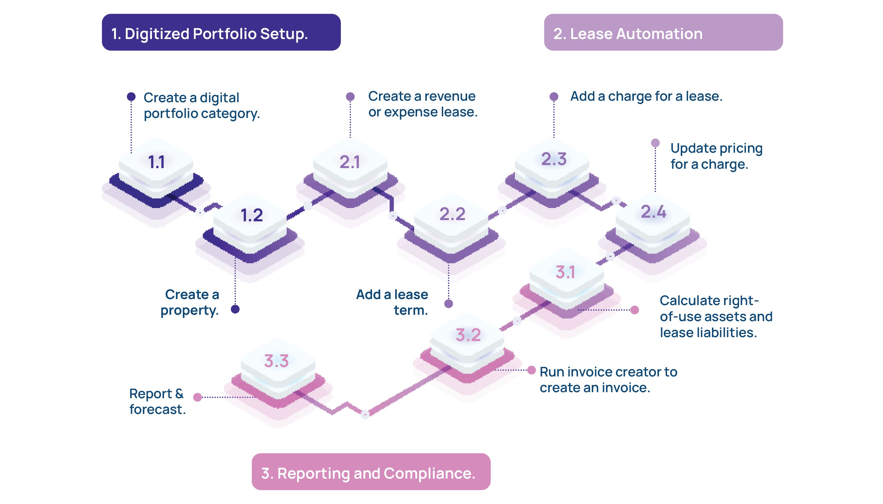
Property & Lease Management lifecycle.

Slide 6

The Market opportunity.
Growing complexity in Lease Accounting and Compliance with IFRS 16 and ASC 842 requirements.
Managing Property & Assets Leases across Multiple Locations.
Real-time Data on Lease Performance.
Difficulty Validating Bills Against Lease Terms.

Slide 7

Property & Lease features.
Flexible multi-level lease management.
Manage multiple levels and groupings of real estate, vehicle fleets, and equipment to suit unique business models .
Scalable lease management.
Leverage scalable revenue and expense lease management with flexible pricing, terms, renewals and terminations.
Simplified compliance for lessee and lessor.
Facilitate compliance with ASC 842 and IFRS 16 for property, plant, and equipment leases.
Real-time lease performance.
Gain real-time insights into your lease portfolio’s performance with intelligent reports and forecasting tools.

Slide 8
Transformation by Functional Area.
1
2
3
Organizational.
Automate industry specific lease and rental operations for PP&E with the ability to design customized levels for shopping malls or vehicles .
Operational.
Optimize Complex Charges and Reconciliations like Common Area Maintenance for both lessees and lessors.
Financial.
In-built Compliance with ASC 842 and IFRS 16 across multiple properties and entities, simplifying month-end closures .

Slide 9
Digitized Portfolio Setup.
P&LM is built with flexibility at the forefront so it can be a perfect fit for each organization’s unique lease portfolio while helping them meet their expectations for growth. The easily configurable property setup accommodates complex business scenarios and completely digitalizes an organization’s lease portfolio and provides them with greater visibility into their cashflows and forecasts.
Manage multiple levels of property to suit your unique business model.
Group properties, vehicle fleets, or other leases for better insight into performance.
Scale with confidence and ease with a streamlined portfolio structure.
Shopping Mall
Tower A
Tower B
Floor 1
Floor 2
Floor 3
Floor4
Lot A
Lot B
Lot C
Lot D
Lot E
Lot F
Lot G
Lot H
Lot I
Lot J
Lot K
Lot L
Residential Building
Floor 1
Floor2
Floor3
Room1
Room2
Room3
Room4
Room5
Room6
Vehicle
Vehicle 1
Vehicle 2
Vehicle 3

Slide 10
Future-proof your lease portfolio with a streamlined term modification process
Lease Accounting Administration.
Set up and manage lease terms, terminations, and renewals with flexibility
Managing complex charges and allocating them properly is the most common point of error when managing multiple leases. Using its powerful automation engine, P&LM eliminates the complexity of managing charges and offers a flexible set of tools for managing charges based on metering, percentages, square footage, or index that streamline the end-to-end lease process
Automated process of the lease space change and lease termination
Increase in charge automatically executed based on renewal terms
Create and modify leases with easy-to-use wizards
Deposits at the lease level

Slide 11



Managing Charges & Reconciliations
Simplify Common Area Maintenance management by automating allocation of shared expenses based on metering, square footage or percentages
Ensure accurate billing and streamlined reconciliations, while maintaining compliance with ASC 842 and IFRS 16
Bill and accept payments for charges based on an index or rate schedules
Sales based rent, massive port one time charge (clean up)
Managing complex charges and allocating them properly is the most common point of error when managing multiple leases. Using its powerful automation engine, P&LM eliminates the complexity of managing charges and offers a flexible set of tools for managing charges based on metering, percentages, square footage, or index that streamline the end-to-end lease process

Slide 12



Reporting and
Forecasting
Key real-time reports:
Property analysis report
Vacancy report
Delinquency report
Rent roll report
Lease details report
Proper tracking of lease-related data is critical for organizations as they attempt to forecast their cashflow, manage their existing portfolio, and prepare for compliance. P&LM is built to centralize all lease data so it is easily analyzed and transformed from unknown to actionable.
With many real-time reports built in, P&LM also excels at building detailed vacancy and delinquency reports, rent roll reports, and lease summary reports that help companies improve their analysis and forecasting leading to better business decisions

Slide 13




How They
Work Together
Unified View
P&LM and MEM Together
Consolidated Reporting
Situation:
ABC Property Holdings owns and manage a portfolio of office buildings, retails spaces, and multi-family homes across cities. They set up multiple legal entities, one for each city or property type, to streamline operations and comply with local regulations.
Challenges:
Managing Leases
Tenant Information
Maintenance Work Orders
Financial Reporting across different properties and entities is complex
Solution:
Entity and Property Setup with MEM
Property & Lease Management with P&LM
Lease Accounting & Compliance
Intercompany Transactions

Slide 14


Key persona – CFO / VP Finance / Controller.
CFO
Compliance with ASC 842 & IFRS 16.
Inability to handle multi-entity lease operations.
Lack of forecasting, budgeting & reporting.
Switching between Business Central &
Property management system.
Challenges in managing common area maintenance charges.

Slide 15

Key Persona – Controller / CFO
How It Relates to Their Role:
Emphasize how P&LM integrates seamlessly with Microsoft Dynamics to enhance financial accuracy and provide real-time visibility into property and lease management financials, helping to drive cost efficiencies and strategic decision-making
Controllers and CFOs are responsible for financial accuracy, compliance, and reporting
They need streamlined processes for lease accounting, especially as regulations change or as the business grows and needs to scale
They also need tools to ensure real-time financial data is accessible to aid in decision-making
Impact created by P&LM:
Enhances financial accuracy and reduces overhead by automating complex billing processes. Enables better cash flow management through precise timing and amount of lease collections
Provides clear visibility on financial impacts of lease agreements across multiple properties and entities, critical for strategic financial planning and reporting
Automates financial entries related to lease payments, simplifying month-end closures
P&LM Features relating relevant in their Role:
Automated Lease Accounting, Billing & Revenue Recognition for lessees & lessors
Real-time Financial Insights & Reports like Rent Roll & Property Analysis
Expense Allocation and Common Area Maintenance
Compliance with ASC 842 and IFRS 16
Digitized Lease Portfolio Management
Multi-Entity Management

Slide 16

Key persona – Finance & Accounting Managers.
Accounting Manger
Handle multiple lease payments and record journal entries.
Manual processes for lease tracking and modifications.
Monitor compliance with lease accounting standards.
Prepare financial reports and manage month-end closing.
Complex billing involving variable charges including Common Area Maintenance.

Slide 17
Key Persona – Accounting Manager
How It Relates to Their Role:
Highlight P&LM’s lease accounting features automating complex calculations, ensuring compliance and streamlining financial reporting. Allowing Accounting Managers to maintain accurate records, simplify month-end close processes, and provide reliable insights into the financial performance of properties and leases
Accounting Managers are responsible for overseeing lease accounting, ensuring compliance with standards like ASC 842 and IFRS 16, managing lease-related journal entries, and maintaining accurate financial records.
They need comprehensive tools to automate complex lease calculations, access detailed lease data, and generate accurate financial reports across multiple properties and entities efficiently
Impact created by P&LM:
Simplifies lease accounting and automates complex calculations related to lease liabilities, right-of-use assets, and straight-line rent adjustments
Ensures compliance with built-in tools for compliance with ASC 842 and IFRS 16 reducing time and effort needed for compliance checks
Consolidates lease data, making it easier to generate reports and perform analysis for multiple properties or entities
Automated journal entries, compliance tracking, consolidated reporting, lease term modification handling and robust financial audit trails
P&LM Features relating relevant in their Role:
Automated Billing based on leases, meter readings and square footage
Track tenant information, manage lease renewals and modifications
Vacancy and Delinquency Reports for vacant properties and payment issues
Easily allocate Common Area Maintenance costs to tenants in shared spaces

Slide 18

Key persona – Lease Analyst.
Lease Analyst
Complex billing involving variable charges.
Lease creation, modification and termination process
for multiple leases across multiple entities.
Accurate lease accounting for multiple properties.
Providing reports based on real-time data.
Compliance with ASC 842 and IFRS 16 for lease accounting.

Slide 19
Key Persona – Lease Analyst
How It Relates to Their Role:
Highlight the capabilities of P&LM to manage complex leases and automate calculations, ensuring compliance and accuracy in lease management, which can significantly reduce the workload and increase the operational efficiency of lease analysts
​
Impact created by P&LM:
Simplifies management of variable lease terms and conditions, improving efficiency in lease administration and reducing billing errors
Allows for quick adjustments to lease terms based on changes in regulations or business strategy, ensuring compliance and adaptability
Lease analysts track lease agreements, payments, and renewals. They are also responsible for ensuring that the proper charges are applied, and payments are recorded accurately
P&LM Features relating relevant in their Role:
Lease creation and modification wizard to set up and update lease terms
Automated Lease Space Changes and Termination
Proper allocation of charges using metering, percentages, and rates to avoid billing errors
Compliance with ASC 842 and IFRS 16 for lessors and lessees accounting processes

Slide 20





Target Industry and Use Cases
Industry | Use Cases
Real Estate (Commercial & Residential) | PP&E for Multi Entity (Revenue & Expense Leases)
Construction | PP&E Management (Revenue & Expense Leases)
Hospitality, Travel, Service & Restaurants | PP&E for Multi Entity (Revenue & Expense Leases)
Broadcasting Stations | PP&E Management (Revenue & Expense Leases)
Energy / Resource | PP&E Management (Revenue & Expense Leases)
Healthcare | PP&E Management (Revenue & Expense Leases)
Manufacturing | PP&E Management (Revenue & Expense Leases)
Transportation & Distribution | PP&E for Multi Entity (Revenue & Expense Leases)

Slide 21

Commercial real estate.
Revenue Lease
Commercial landlords lease our spaces to tenants and earn rental income.
Value proposition:
Streamlined Lease Management Ensuring Error-free and Efficient Management.
Accurate Common Area Maintenance (CAM) Charges based on Metering, Square Footage, Percentage.
Real-Time Financial Insights on occupancy rates, rent roll and cash flow forecasting.
Expense Lease
Businesses leasing commercial space incur expenses for using the property.
Both
Property owners leases spaces to tenants (Revenue) and lease equipment or other properties themselves (Expense).

Slide 22
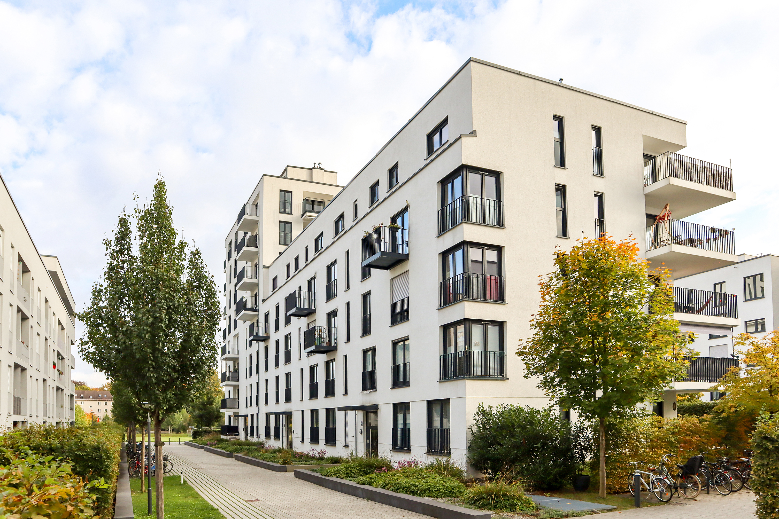
Residential real estate.
Revenue Lease
Landlords leasing out residential properties to tenants.
Value proposition:
Automated Tenant Management for Multi-Unit Residential Properties.
Accurate Billing and Payments Improving Cashflow Management.
Comprehensive Reporting and Forecasting into Occupancy Rates, Rent Rolls and Delinquency Reports.
Expense Lease
Tenants lease the property and incur rental expenses.

Slide 23

Services industry.
Revenue Lease
Service providers lease out parts of their facilities (e.g., Spa leasing out treatment rooms to independent therapists).
Value proposition:
Customizable Lease Solution to Manage Office Spaces and Asset Rentals.
Accurate Billing and Expense Management to Streamline Operational Overhead.
Real-Time Visibility and Reporting into Asset Utilization for Efficient Resource Management.
Expense Lease
Service businesses lease office space, equipment, or vehicles needed for their operations.
Both
Service providers may lease their own facilities or equipment (Expenses) and lease out part of their facilities to other businesses (Revenue).

Slide 24

Health care industry.
Revenue Lease
Healthcare providers lease out office space or specialized equipment.
Value proposition:
Simplified Lease Management for Medical Facilities and Equipment.
Accurate Cost Allocation and Compliance across Multiple Departments and Facilities.
Real-Time Financial Reporting and Forecasting for Budget Planning .
Expense Lease
Healthcare facilities lease medical equipment, office space, or buildings.

Slide 25

Automotive/Vehicle industry.
Revenue Lease
Service providers lease out parts of their facilities (e.g., Spa leasing out treatment rooms to independent therapists).
Value proposition:
Centralize lease and asset management for a 360° view of corporate health.
Expand revenue models and added flexibility to meet changing customer demands.
Achieve accounting compliance and minimize global risk and reduce overhead costs.
Expense Lease
Service businesses lease office space, equipment, or vehicles needed for their operations.
Both
Service providers may lease their own facilities or equipment (Expenses) and lease out part of their facilities to other businesses (Revenue).

Slide 26

Restaurant industry.
Revenue Lease
Restaurants lease out parts of their premises for events or to other businesses.
Value proposition:
Efficient Lease and Asset Management for Multiple Locations and Kitchen Equipment Rentals.
Accurate Cost Allocation and Common Area Maintenance (CAM) Management.
Real-Time Financial Insights for Cost Optimization Across Multiple Locations.
Expense Lease
Restaurants commonly lease the space in which they operate.
Both
Restaurants lease space (Expense) and lease out sections for events of sublets (Revenue).

Slide 27

Broadcasting stations industry.
Revenue Lease
Broadcasting stations might lease out broadcasting rights or infrastructure.
Value proposition:
Comprehensive Lease Management for Broadcast Infrastructure.
Automated Billing for Shared Transmission Sites Including Common Area Maintenance Charges.
Real-Time Financial and Asset Insights to Optimize Cashflow.
Expense Lease
Broadcasting stations lease equipment, office space, or transmission towers.

Slide 28
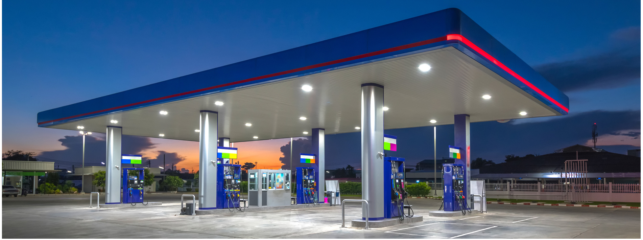
Energy, resources and fuel station industry.
Revenue Lease
Fuel Stations lease parts of their property, such as convenience stores or additional retail space.
Value proposition:
Centralized Management of Multi-Site Leases Providing Centralized Platform.
Accurate Billing and Charge Allocation Across Multiple Sites Reducing Admin Burden.
Enhanced Financial Forecasting and Compliance for Expansion and Resource Allocation.
Expense Lease
Fuel Stations lease the land or property on which they operate.

Slide 29

Manufacturing industry.
Revenue Lease
Manufacturers lease out unused parts of their facilities or equipment.
Value proposition:
Streamlined Equipment and Facility Lease Management Reducing Downtime.
Accurate Asset Tracking and Cost Allocation Across Multiple Production Sites.
Compliance and Financial Forecasting Into Lease Liabilities, Cashflow Forecasts and Asset Performance.
Expense Lease
Manufacturers lease equipment, factories, or storage facilities.

Slide 30
Competitive analysis (Soft4).
Top 3 things making Soft 4 win.
All in one solution for lease management, accounting, and financial processes. It combines features like work order, portal, and contract templates for automotive industry, equipment leasing, and asset finance.
Billing Automation with comprehensive distribution of CAM (error, volume).
Business insights and reporting capabilities.
How should we respond when they come up in sales conversations.
Multi-entity lease accounting compliance.
P&LM is designed to handle complex lease accounting and compliance with ASC 842 and IFRS 16. Soft4 is strong in leasing for specific industries but doesn’t offer the same robust lease accounting capabilities, especially for multi-entity organization.
Advance CAM calculation.
P&LM has same functionalities, but offers more advanced CAM calculation methods.
Scalability & lower cost of ownership.
We have same reporting capabilities and lower cost of ownership.

Slide 31
Competitive Analysis (Yardi).
Top 3 things making Yardi win.
Integrates functions like maintenance, lease management, and accounting in one place for property managers. Strength lies in supporting front-office tasks to back-office accounting.
Widely used in real estate industry and tailored specifically for property management. Go-to solution for multifamily, commercial, and mixed-use properties.
Provides deep analytics and reporting capabilities, tracking operational performance, tenant satisfaction, and financial metrics.
How should we respond when they come up in sales conversations.
Integration with Microsoft BC and MEM:
P&LM is embedded within BC and integrates with Binary MEM solution, allowing to manage leases and properties within Dynamics 365 ecosystem. Better data accessibility, compliance, and operational visibility for BC users.
Lease Accounting & Compliance:
Advanced lease accounting capabilities, including ASC 842 and IFRS 16 compliance, crucial for multi-entity or large-scale organizations. Yardi doesn’t offer same depth in accounting automation and compliance.
Cost & Flexibility Advantage:
P&LM offers a lower cost of ownership vs Yardi’s licensing and implementation fees.

Slide 32
Competitive Analysis (RealPage).
Top 3 things making RealPage win.
Unified platform integrating property management, leasing, maintenance, and accounting. Caters to multifamily, student housing, and commercial properties.
Provides strong business intelligence and analytics tools, offering real-time insights into operational and financial performance. This helps property managers analyze data across the entire portfolio.
Focuses heavily on enhancing resident experience through digital portals and features like virtual tours, smart home integration, and AI backed leasing assistants help to improve resident engagement.
How should we respond when they come up in sales conversations.
Integration with Microsoft BC and MEM:
P&LM is embedded within BC and integrates with Binary MEM solution, allowing to manage leases and properties within Dynamics 365 ecosystem. Better data accessibility, compliance, and operational visibility for BC users providing a single source of truth across all properties and leases.
Lease Accounting & Compliance:
Advanced lease accounting capabilities, including ASC 842 and IFRS 16 compliance, crucial for multi-entity or large-scale organizations. RealPage doesn’t offer same depth in accounting automation and compliance.
Cost & Flexibility Advantage:
P&LM offers a lower cost of ownership vs RealPage’s higher costs for large portfolios and additional modules. P&LM being embedded within Microsoft BC ensures scalability as portfolio grows, without need for costly third-party integrations.

Slide 33
Competitive Analysis (LeaseQuery).
Top 3 things making LeaseQuery win.
Built specifically for lease accounting and compliance with ASC 842, IFRS 16, GASB 87. Helps manage lease liabilities, disclosures, and complex reporting requirements with precision making it effective for accounting professionals.
Designed by CPAs, built by accountants for accountants.
Automatic journal entry creation and posting to general ledgers, reducing risk of manual errors. Integrates with BC.
How should we respond when they come up in sales conversations.
Broader Integration with Microsoft BC and MEM:
While LeaseQuery integrates with BC, P&LM offers a more comprehensive solution, fully embedded in MC and integrating with MEM, allowing for unified management of both property and lease portfolios, with added benefit of handling multi-entity accounting in a consolidated environment.
Holistic Solution:
P&LM combines lease accounting and property/asset management for managing leases, tenants and accounting processes. Better fit for businesses needing both operational and financial management.
Cost-Effective & Scalable:
P&LM offers a lower cost of ownership for BC users. Integration with MEM ensures scalability without the need for additional systems or complex third-party integrations.

Slide 34
Competitive Analysis (Yavica).
Top 3 things making Yavica win.
Comprehensive integrated platform for real estate management. Tenant & property management, billing, utility management, and risk control. Great fit for full lifecycle real estate functionality needs.
Handle strategic planning, portfolio optimization, and multi-location management. Utility consumption tracking, tenant communication portals, and detailed construction management.
Similar to P&LM, Yavica is built on Dynamics 365 however positioned as a real-estate specific solution.
How should we respond when they come up in sales conversations.
P&LM integration with MEM:
P&LM offers a broader scope by integrating directly with MEM. Consolidate operations and financial reporting more effectively.
Lease Accounting Compliance:
P&LM’s focus on lease accounting compliance for ASC 842 and IFRS 16, paired with MEM functionality, offers a powerful combination that Yavica does not directly compete with.
Cost-Effective & Scalable:
P&LM offers a lower cost of ownership for BC users. Yavica extensive features come with higher implementation and management costs, especially for multiple entities. P&LM is more scalable and cost effective for companies managing both property and financial operations.

Slide 35
Competitive Analysis (Dynamics Property).
Top 3 things making competitors win.
Manage properties, contracts, utilities from multiple companies into one.
Streamline lease and financial management. Handle lease renewals, maintenance requests, rent collection, and centralized reporting.
Integration with BC, Power BI, Azure and offers robust reporting and analytics for property managers to analyze occupancy rates, maintenance costs and financial performance.
How should we respond when they come up in sales conversations.
Deeper integration with MEM:
While Dynamics Property integrates well with Microsoft ecosystem, P&LM offers MEM integration for multi-entity consolidation, useful for global operations.
Advance Lease Accounting & Compliance:
ASC 842 and IFRS 16 compliance, crucial for multi-entity or large-scale organizations. Dynamics Property doesn’t offer same depth in accounting automation and compliance.
Scalability for Global Operations:
P&LM is more scalable solution for global operations or complex entity structures.

Slide 36
Competitive Analysis (Dynamic Tenancy Management).
Top 3 things making competitors win.
Designed for managing tenancy occupancies for shopping malls, condominiums, offices, apartments, coworking spaces & commercial areas.
Automate lease, utility and retail sales computations, monitoring renewals, tracking vacancies, generating bills, and managing customer information.
Built on the Microsoft Dynamics 365 platform.
How should we respond when they come up in sales conversations.
Deeper integration with MEM:
While Dynamics Tenancy integrates well with Microsoft ecosystem, P&LM offers MEM integration for multi-entity consolidation, useful for global operations.
Advanced Automation and Compliance:
Dynamics Tenancy focuses more on tenant and property management, whereas P&LM is designed to handle the intricacies of lease accounting and compliance with ASC 842 & IFRS 16.
Scalability & Financial Management:
P&LM when combined with MEM, offers a more scalable solution .

Slide 37






P&LM Recent Wins on Business Central.
  Segment by:
Use case
Using BC MEM, ARCB and needed Property management
Industry
Construction
Company Size
Using BC MEM, ARCB and needed Property management
Most Used Features
ASC 842 calculation
All expense leases
Residential lease
  Segment by:
Use case
Revenue Lease, CAM
Industry
Real Estate Management Services
Company Size
Using BC MEM, ARCB and needed Property management
Most Used Features
Revenue lease
CAM (Common Area Maintenance)
Expense Allocation

Slide 38


P&LM Recent Wins on Business Central.
  Segment by:
Use case
Using BC-MEM, required IFRS 16 Calculation and expense leases
Industry
Hiring and Staffing (Commercial Real Estate, Office Lease)
Company Size
Using BC MEM, ARCB and needed Property management
Most Used Features
IFRS 16 Calculation
All expense leases
  Segment by:
Use case
Using BC-MEM
Industry
Healthcare
Company Size
Using BC MEM, ARCB and needed Property management
Most Used Features
IFRS 16 Calculation
All expense leases
Equipment

Slide 39
Real results from real customers.
Say goodbye to manual lease management and complex accounting. Property & Lease gives you full control of your lease operations right within your Microsoft ERP solution.
30+
550+
120k+
100%
locations managed through a unified lease platform.
leases tracked and automated in one system.
square feet of leased space managed with full visibility.
embedded with Microsoft ERP solutions.

Slide 40
Wrap Up
Have an amazing start to 2025!
Connect with your account manager or email sales@binarystream.com to continue the conversation.

