Slide 1

Dynamic solutions for Microsoft ERP customers.
We help businesses using Microsoft ERP solve complex financial and operational challenges.

Slide 2




Subscription Billing.
Dynamics 365
Business Central

Slide 3

Embedded vs Standalone Subscription Solutions.
Use case.

Slide 4





Subscription Features Added to BC.
Management of Service Commitments.
Invoice Preview using Billing Templates.
​Automatic Straight-line Deferrals.
Usage Billing.

Slide 5
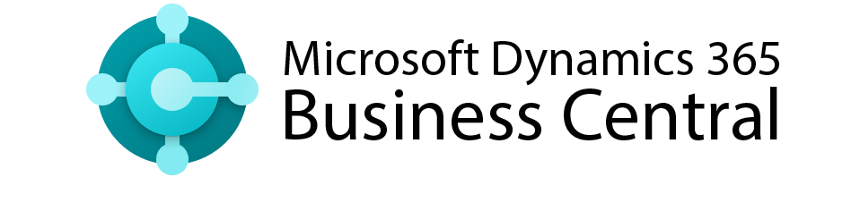
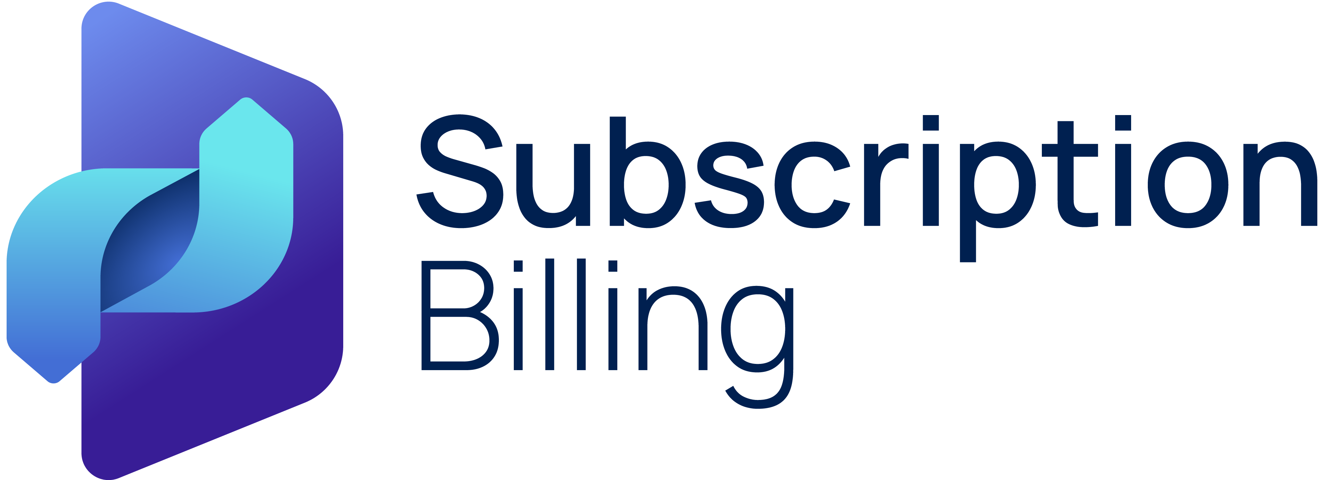
Comparing Core Business Central with Binary Stream Solutions.
Service Subscription Management | Service Subscription Management + Stock Item Subscription, Complex Contract Management
Revenue Management | Revenue Management + Long & Short-term Deferral for Revenue, COGS and Discount, ASC 606 & IFRS15 Compliance
Price Management | Price Management + Escalations, Promotions, Discounts and CPI Increases
Automatic Renewal | Automatic Renewal + Evergreen Contracts, Renewal Levels & Renewal Reports
Usage Billing | Usage Billing + Tier-Pricing Support, Consumption Commitments & Billing Limits
Invoicing | Invoicing + Batch Invoicing, Milestone Billing and Invoice Consolidation

Slide 6


SBS vs Business Central Core Subscription.
End-to-end SBS Bundle – Billing, collections, payment processing & Reporting
Portal – Self-serve to manage subscriptions, view invoices, and make payments
Integrations – With Microsoft CSP Portal, third-party products and CR
Compliance – ASC 606 & IFRS 15 compliance for bundled products, revenue allocation
Reporting – MRR, Renewals, Churn, Profit Margin, Solver Reports
Advanced Recurring Billing & Revenue Recognition – Handle various billing needs, fully compliant with ASC606 and IFRS15

Slide 7
Contract Creation.
Feature.
Create Contracts from a Sales Order.
Create Contracts from a CRM.
Start a Contract upon item Shipment.
Sales Contracts.
Purchase Contracts.

Slide 8
Contract Management.
Feature.
Renewals.
Termination.
Align to start/end date of the month.
Align to any other day of a month.
Change quantity of a contract item in middle of the period.
Calendar billing.

Slide 9
Price Management.
Feature.
Support item pricing.
Price escalation.
Billing period discount.
Update contract prices.
Minimum & Maximum price or quantity .

Slide 10
Invoicing.
Feature.
Mass invoice creation.
Invoice consolidation (Bill-to, ship-to, Items, end users).
Bundle items.
Milestone billing.

Slide 11
Revenue Deferral.
Feature.
Defer and recognize revenue of a stock item
Adjust deferral schedule.
Event-based deferral.
Unbilled revenue.
Performance obligations identified under ASC 606 and IFRS 15 standards

Slide 12
Usage billing.
Feature.
Upload usage.
Upload meter reading.
Tier-pricing.
Consumption commitments.
Billing limits.

Slide 13
Self-serve Portal.
Feature.
Allow customers to review their contracts from a portal.
Allow customers to pay outstanding invoices.
Allow customers to review payment history.
Pre-authorized payments automation (Stripe, Go Cardless).
Ability to update contracts including approval workflow.
Support sale through the CSP partner channel and update the Microsoft partner center.

Slide 14
Integrations.
Feature.
Create contract from CRM or 3rd party products via APIs.
Update contracts from CRM or 3rd party products via APIs.
Upload contract usage via APIs
Terminate contracts from a CRM or 3rd party via APIs.
Terminate contracts via APIs and create credit memos.

Slide 15
Reporting.
Feature.
Report on a bill-to and sell-to customer (partner / end user).
Report on contract revenue (MRR, Profit Margin and more).
Report on upcoming events (renewals, churn and more).
Report on deferred and recognized revenue .
Support audit trail functionality for contract/deferral change.
Custom reports powered by Solver

Slide 16

Binary SBS vs Chargebee.
Competitive Analysis.

Slide 17
Competitive Analysis Chargebee.
Top 3 Advantages of Chargebee.
Excels in complex subscription models, recurring billing, one-time charges, and usage-based pricing. Advanced revenue recognition, suitable for SaaS, education, and e-commerce businesses.
Supports wide variety of payment gateways, credit cards, ACH, and international payment for global operations.
Customer self-serve portal to manage subscriptions, billing, and invoices without involving customer support.
How does Binary Stream Compete.
Microsoft Integration.
Lower Cost of Ownership.
Advanced Solver Reporting.
Chargebee lacks direct integration with Business Central & Microsoft CSP Portal whereas SBS is embedded within BC. This provides seamless, end-to-end management of the entire order-to-cash process, eliminating the need for system reconciliation, removing data silos, ensuring centralized data within BC, a unified user interface, and reducing security and compliance risk.
Chargeebee has steeper learning curve and requires more time to configure. Pricing starts at $599/month, and additional charge for ERP integration, invoice consolidation, manual discounts, report builder, contract terms and more than 3 currencies. Whereas SBS offers more cost effective and scalable pricing.
Both solutions offer subscription analytics and reporting, but Binary Stream Advanced Reporting module allows detailed financial planning, deeper visibility into subscription revenue and AR performance.

Slide 18

Binary SBS vs Recurly.
Competitive Analysis.

Slide 19
Competitive Analysis (Recurly).
Top 3 Advantages of Recurly.
Recurring billing system for managing different billing frequencies, pricing models, and coupons and free trials.
Wide variety of payment gateways (Stripe, Braintree, PayPal, credit & debit cards, digital wallets).
Integrations with Salesforce, QuickBooks, Xero, HubSpot and more, suitable for companies with complex tech stack.
How does Binary Stream Compete.
Microsoft Integration.
Scalable & Cost Effective.
End-to-end solution.
Unlike Recurly, SBS is embedded within BC, allowing seamless end-to-end management of the entire order-to-cash process. With SBS, there is no need for system reconciliation, ensuring centralized data within Business Central, a consistent user interface, and reduced security and compliance risk
Lower total cost of ownership as Recurly starts at $290 and charges more for language support, ACH, account activity import/export, customer fields, invoice receipt and intelligent retry.
More extensive solution than Recurly, covering subscription billing, AR & Collections management, and Advanced Reporting module for financial planning & analysis.

Slide 20
Real results from real customers.
From automated billing and collections to revenue recognition and real-time reporting, simplify your recurring revenue operations, and streamline your compliance saving you valuable time and money. Don’t just take our word for it, see what our customers have achieved.
$120K
50%
10K
80+
annual cost savings.
workload reduction.
deferral accounts in one implementation.
days saved annually.

Slide 21
Wrap Up
Have an amazing start to 2025!
Connect with your account manager or email sales@binarystream.com to continue the conversation.

