Slide 1

Dynamic solutions for Microsoft ERP customers.
We help businesses using Microsoft ERP solve complex financial and operational challenges.

Slide 2




Advanced Subscription Management for Dynamics 365 Finance

Slide 3

Transform subscription billing with Advanced Subscription Management (ASM).
ASM empowers businesses to handle diverse pricing and invoicing models effortlessly with features like price adjustments on invoiced contracts, custom billing cycles, flexible invoice splitting, and user-defined custom fields, providing unmatched flexibility to tailor billing schedules, contracts, and reporting, to your specific business needs.
ASM combines these advanced capabilities into a single, intuitive platform, seamlessly integrated with Dynamics 365 Finance, offering a highly desirable SaaS solution that empowers businesses to scale efficiently while maintaining control and compliance.

Slide 4

Key characteristics of subscription economy.
Recurring Revenue model.
Payment portal experience.
Continuous
value delivery.
Customer centric focus.
Relying on customer payments and predictable recurring revenue .
Addressing customer churn with seamless payments.
Provide ongoing value to consumers with regular updates and new features.
Focus on customer engagement and satisfaction

Slide 5


Subscription Billing History.
+
Dynamics 365 Finance
2006
2017
2021
2022 | Spring
2022 | Fall
 | Binary Stream launches a solution for subscription management. |  | Binary Stream solutions available in Dynamics 365. | Microsoft licenses Subscription Billing Suite for Dynamics 365 Finance. | Subscription billing is made generally available in Dynamics 365 Finance. |  | Advanced Subscription Management launched for Dynamics 365 Finance.

Slide 6



About Binary Stream.
Fully embedded Solutions in Dynamics 365 F & O
25 years of industry innovation.
Global recognition and reach.
Built to reduce the cost of ownership by leveraging existing strengths in the Dynamics Finance platform.
Providing solutions across manufacturing, financial services, SaaS, healthcare, real estate, and public sector
A trusted provider to 3,000+ customers across 25 countries.

Slide 7





Why include Binary Stream?
Our knowledge of
the solution.
Our knowledge of industry best practices.
Additional resources.
The end result.
How Binary Stream benefits.
As the original authors of the module Binary Stream understands the features, functions, and workarounds available in the solution.
Binary Stream has
in-depth knowledge of billing and revenue recognition practices. Prospects and clients value this knowledge when undergoing Subscription Billing business transformation.
Adding additional specialized resources to your sales purists provides you additional time to focus on other aspects of the sales engagement.
Binary Stream has had over 60 won Dynamics Finance engagements as the SB SME.
This consistent win record helps you win in compete scenarios with competitors like NetSuite.
In successful purists Binary Stream will implement the Subscription Billing module for the client.
So we only win if you win.

Slide 8



Benefits of Subscription Billing.
Comprehensive financial reporting.
Advanced financial reporting offers deep insights into revenue KPIs and the entire subscription lifecycle.
Automated compliance & collections.
Ensure compliance with ASC 606 and IFRS 15 through automated processes and accurate financial reporting.
Seamless scalability.
Tailor your billing processes to fit your company’s needs and effortlessly scale as your business grows.

Slide 9



Subscription Billing Suite features.
A comprehensive suite of solutions covering every step in the subscription billing management cycle.
Highly flexible and accommodates a wide range of pricing and billing structures including usage-based, tiered, milestone, and more.
Takes the hassle out of your audit process and paves a clear path towards compliance with ASC 606 and IFRS 15.
Includes real-time reports and forecasting tools with intelligent insights across all your revenue streams.

Slide 10
Subscription Billing Module functionality .
An Out of the Box module in Dynamics Finance that handles the subscription billing management cycle.
Highly flexible and accommodates a wide range of pricing and billing structures including usage-based, tiered, milestone, and more.
Takes the hassle out of your audit process and paves a clear path towards compliance with ASC 606 and IFRS 15.
Includes real-time reports and forecasting tools with intelligent insights across all your revenue streams.

Slide 11
Subscription Billing Module benefits.
Allows users to automate their billing, deferral, and revenue reallocation. This increases efficiency, reduces errors, and enables customers to scale rapidly.
Provides users flexibility in how the price, bill, and generally sell items. This facilitates business transformation in how companies sell to their customers.
Allows users to replace costly third-party solutions or labor-intensive manual processes.
Advanced reporting allows decision-makers to gain insights into their business that allows them to make better decisions.

Slide 12




Verticals that can utilize Subscription Billing.
Software.
The software industry can utilize many aspects of the Subscription Billing module
Membership organizations.
All membership organizations, from gyms to professional service designation membership orgs can utilize Subscription Billing.
IOT companies.
Companies who provide physical devices and then charge additional fees for usage and servicing. Some examples are telematics companies, large medical devices, and electric car chargers.
Physical goods.
Companies that provide physical goods that are shipped on a recurring basis or have an accompanying service contract.

Slide 13




When is Subscription Billing and ASM a fit in your Workflow?
Time Consuming Manual Billing Processes
Time Consuming Manual Revenue Recognition Or Reallocation Processes
Using Expensive Third-party Billing and Rev Rec solutions
Want to provide your customers with self-serve payment capabilities

Slide 14
When to call Binary Stream.
Prospects say:
1.
2.
3.
4.
We have recurring revenue requirements.
We have complex pricing models.
We have consumption-based billing.
We have milestone-based billing.
5.
6.
7.
8.
We need to defer revenue or expense.
We have ASC 606 requirements.
We need to reallocate revenue.
We want to change the way we sell our products or services.

Slide 15
Why bring us in early.
1.
2.
3.
4.
Building confidence in Subscription Billing.
We help the prospect gain confidence in the Subscription Billing module starting with the discovery questions we ask.
Critical for decision makers.
Subscription Billing is a mission critical area for decision makers, we ensure the first time it is shown the right impression is made.
Free presales support for Microsoft sellers.
Presales support is provided to Microsoft sellers for free.
Integrated sales approach.
We can join a sales pursuit as an extension of your team, we are often brought in as “Microsoft’s Subscription Billing experts” instead of a distinct company.

Slide 16
Binary Stream’s
ASM for Dynamics
365 F&O

Slide 17


Advanced Subscription Management for Dynamics 365 Finance.
Seamless Dynamics 365 Sales integration.
Pre-built connector that seamlessly integrates with Dynamics 365 Sales CE to bring your sales quotes directly into Dynamics Finance as billing schedules.
Self-serve payments portal.
Empower your customers with a self-serve portal, enabling them to effortlessly view and pay invoices, track payment history, and manage billing with ease.
Extends Dynamics Finance Billing and Rev rec functionality.
ASM provides additional functionality inside of Dynamics Finance, solving for use cases the out of the box Subscription Billing can not handle.
Pricing information.
ASM costs users $20 per user per month. The price point is typically negligible when compared to stand alone billing solutions.

Slide 18
Advanced Subscription Management for Dynamics 365 Finance.
Seamless Dynamics 365 Sales integration.
Pre-built connector that seamlessly integrates with Dynamics 365 Sales CE to bring your sales quotes directly into Dynamics Finance as billing schedules.
Self-serve payments portal.
Empower your customers with a self-serve portal, enabling them to effortlessly view and pay invoices, track payment history, and manage billing with ease.
Automated price adjustments.
Enables the user to adjust prices on invoiced contracts and have the system re-bill a previously invoiced period with a credit note.
Customizable billing cycles.
Tailor invoicing schedules to align with customer preferences or business operations.

Slide 19

Why Subscription Billing is critical in sales pursuits.
Out of the Box Integration with CE and Payment Portal.
Subscription Billing with ASM allows fully automated quote to cash all within the Microsoft stack. This is a compelling story that competitors can’t match.
Keeps all functionality in the Microsoft Stack.
Introducing third-party billing solutions can introduce risk as they work with all ERPs. With expensive volume-based pricing, they leave less of the wallet share for Microsoft solutions.
Facilitates conversations around business transformation.
The Subscription Billing module enables customers to sell and price items in ways they never could before. This allows you to talk to the art of the possible, not just how you can do today’s process more efficiently.
Opens doors in the C-Suite.
Generating revenue in new ways and increasing operational efficiency gets more interest from CROs’ CFOs, and CEOs than most other areas of an ERP implementation.

Slide 20
Subscription Billing Suite + Dynamics 365 Finance.
SUBSCRIPTION BILLING SUITE
COMPLEX CONTRACTS MANAGEMENT
REVENUE AND EXPENSE RECOGNITION
MULTI-ELEMENT REVENUE ALLOCATION
REPORTING AND FORECASTING
FINANCIAL MANAGEMENT
TAX MANAGEMENT
REGULATION & COMPLIANCE
CHARTS OF ACCOUNTS
CREDIT & COLLECTIONS
BUDGETING
CASH MANAGEMENT
JOURNAL MANAGEMENT
1
Dynamics 365 Finance
Microsoft Azure

Slide 21
Advanced Subscription Management + Dynamics 365 Finance.
ADVANCED SUBSCRIPTION MANAGEMENT
ADVANCED INVOICING OPTIONS
ADVANCED PRICING & BILLING MANAGEMENT
DYNAMICS SALES CE INTEGRATION +PAYMENT PORTAL
SUBSCRIPTION BILLING SUITE
FINANCIAL MANAGEMENT
TAX MANAGEMENT
REGULATION & COMPLIANCE
CHARTS OF ACCOUNTS
CREDIT & COLLECTIONS
BUDGETING
CASH MANAGEMENT
JOURNAL MANAGEMENT
1
Dynamics 365 Finance
Microsoft Azure

Slide 22
CPQ
CRM
Payment gateway
Contract setup
Outstanding invoice detection
Invoice/sales
order creation
Recurring
invoices
Internal notifications
IoT
Payment portal
Automated reminders
Deferrals
management
Transaction
posting
Collections management
Email services
eComm
Recognition
processing
Revenue
recognition
Dispute resolution reporting
PowerAutomate
SBS
AR&CM
APIs
Dynamics 365 Finance

Slide 23






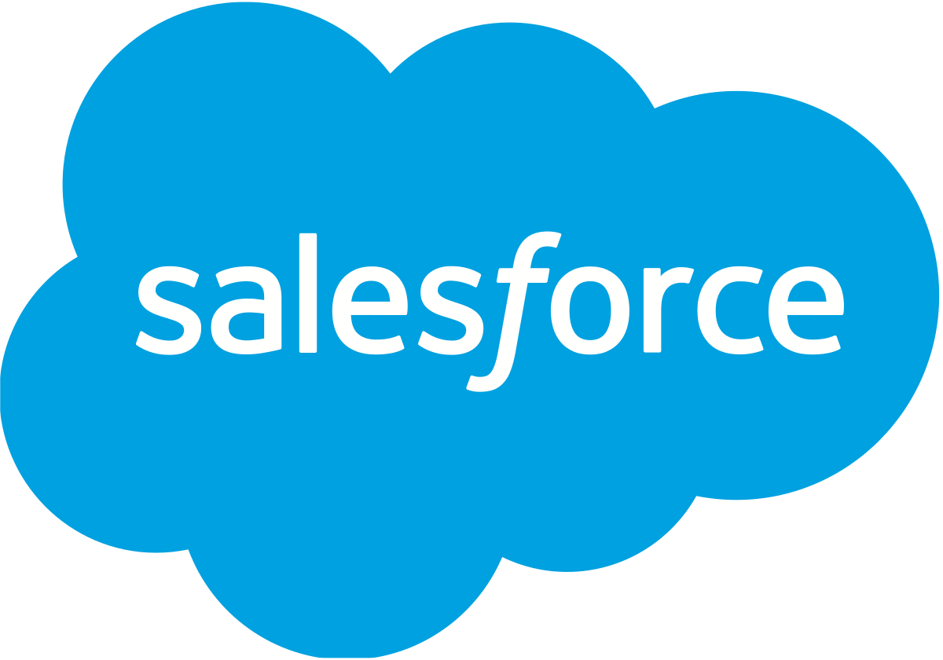


OOTB Subscription Billing process.
Data sources
Contract
Contract setup
Invoice / sales order creation process
Sales invoices
Transaction posting
Direct inputs
D365 Commerce
D365 Sales
Salesforce
Revenue recognition journal entries
Magento
Deferral schedules
Recognition processing
Revenue recognition journal entries
Metering tools
Dynamics 365 Finance

Slide 24


Subscription Billing with ASM process.
Approved Quote
Dynamics Finance Invoice
ASM Dynamics 365 Sales Integration
Changes to Billing Schedule
Billing schedule
Invoice / sales order creation process
Recurring sales invoices
Payment Journal
ASM Self Serve Payment Portal
Transaction posting
Deferral schedules
Recognition processing
Revenue recognition journal entries
Revenue recognition journal entries
+
Dynamics 365 Finance
ASM

Slide 25
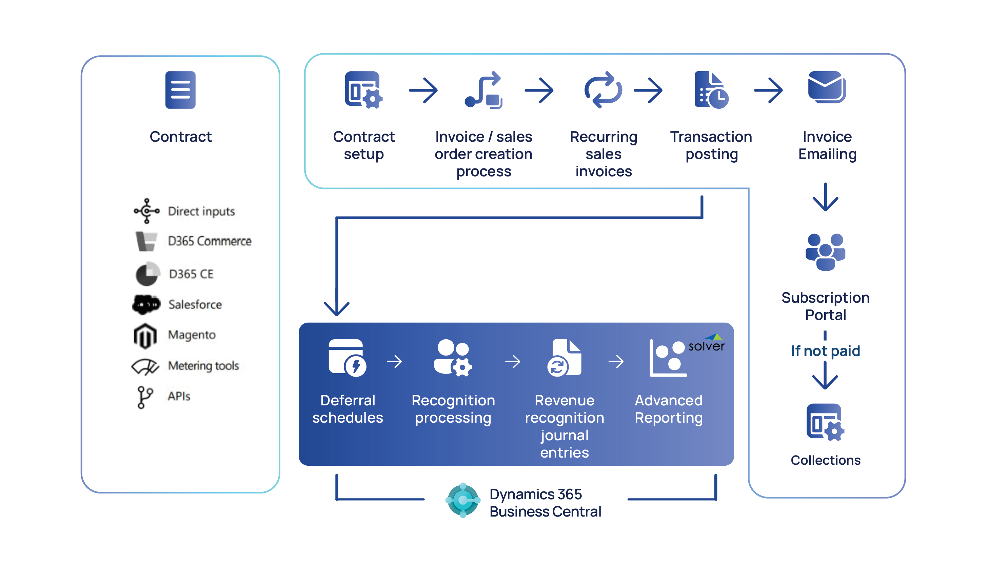
Order to Cash Process.
D365 Finance

Slide 26
Implementation & Professional Services

Slide 27

How Binary Stream helps you activate Subscription Billing.
Streamlined subscription management.
Effortless scaling and integration.
Tailored implementation services.
Binary Stream extends Dynamics Finance’s Subscription Billing with Advance Subscription management, allowing customers to fill key gaps without customization.
Binary Stream’s expertise in Subscription Billing helps activate Dynamics Finance’s new Subscription Billing Module for existing customers, offering a seamless transition from manual processes or expensive third-party software.
Binary Stream can assist in net new Dynamics Finance implementations. We provide implementation services for just the Subscription Billing Module.

Slide 28
Discovery & Fit-Gap Assessment
Discovery & Functional Fit Assessment
Needs Analysis & Solution Discovery
Final Presentation + Solution Synopsis
Recurring Billing & Deferrals
Identify Fits and Gaps
Cross Functional Integrations
Current State Assessment
Data Migration
Reporting & Analytics
Key findings
Implementation Proposal
Enhancements & Customizations

Slide 29
Migration value.
Smooth transition:
Migration support:
Pre-packaged solutions:
Consistent guidance:
Facilitate a seamless move from the old RevRec functionality to subscription billing with minimal disruptions to ongoing projects.
Utilize Binary Stream’s migration utility and packaged services to minimize project risks and avoid unnecessary delays.
Benefit from offerings with known timelines and clear, expected outcomes.
Rely on dedicated advisors and aligned presales/service delivery resources to ensure customer satisfaction throughout the migration process.

Slide 30
Guarantee long-term success with our services.
Comprehensive support and resources:
Subscription management expertise:
Engineering alignment and collaboration:
3
1
2
Empower your team with training, support, and additional resources to implement subscription billing functionality in Dynamics 365 Finance and handle larger project bandwidths.
Gain insights into roadmaps and work with Microsoft and partners for successful subscription billing implementation.
Leverage domain knowledge to create roadmaps for IFRS 15 and ASC 606 compliance while ensuring a proven approach to solution delivery.

Slide 31
Partner for Success with Binary Stream
Streamlined subscription management.
Effortless scaling and integration.
Tailored implementation services.
Rely on dedicated advisors and delivery resources to ensure a successful implementation
Designed services to facilitate a seamless move with minimal disruptions
Benefit from packaged offerings with known timelines and clear expectations

Slide 32

Generating revenue and increasing user experience for your existing dynamics finance customer base.
Binary Stream can assist you in prospecting your existing Dynamics Finance install base to see if they can benefit from activating Subscription Billing.
Binary Stream can provide prospecting questions to see if the client can potentially benefit from Subscription Billing.
Binary Stream offers a Solution Fit Evaluation process .
In this process we map the clients billing and deferral requirements to Subscription Billing capabilities.
We propose solutions to any gaps.
We explain the business value of implementing the Subscription Billing.
We outline implementation costs and costs of additional Dynamics Finance licenses .

Slide 33

Generating revenue and increasing user experience for your existing dynamics finance customer base.
Benefits for your client:
The client benefits as they can replace costly third-party solutions or cumbersome manual processes with functionality.
They are able to simplify their tech stack or business processes
Benefits for you:
In order to utilize Subscription Billing they will need to add additional dynamics finance license.
With the out of the box integration with CRM cross sell opportunities are opened up.
Reopens the conversation around adjusting a clients tech stack to include additional pieces from the Microsoft ecosystem.

Slide 34
Real results from real customers.
From automated billing and collections to revenue recognition and real-time reporting, simplify your recurring revenue operations, and streamline your compliance saving you valuable time and money. Don’t just take our word for it, see what our customers have achieved.
$120K
50%
10K
80+
annual cost savings.
workload reduction.
deferral accounts in one implementation.
days saved annually.

Slide 35
ASM Demo

Slide 36



Sample company – Factory Software Corp.
  This company provides software solutions, data storage, and professional service engagements .
  This is a fictional company created in D365, but all use cases resemble real life scenarios

Slide 37

Use Case – Advanced Revenue Recognition .
Factory Soft. has a two year contract with their customer, in this contract they have:
A Data Storage Subscription billed quarterly in arrears with the price escalating $300 a quarter for the duration of the contract.
Factory Software needs to recognize the same amount of revenue each month for the duration of the contract .
In this scenario the contract is terminated after two months and the client must receive a partial credit, with the system making the necessary adjustments to revenue.

Slide 38

Use Case 1- Contract Billing scenario.
Twin Rivers has a contract with their customer, in this contract they have:
A data storage subscription billed annually with its revenue deferred over the year.
A charge for GB of data used. This is billed on a useage basis, and has tiered pricing as well as a maximum billing amount each month.
An implementation fee, where portion of the fee is billed as milestones are hit.

Slide 39
Use Case 2– Advanced Revenue Recognition .
Twin Rivers has a two year contract with their customer, in this contract they have:
A Data Storage Subscription billed quarterly with the price escalating $300 a quarter for the duration of the contract.
Twin Rivers needs to recognize the same amount of revenue each month for the duration of the contract .
In this scenario the contract is terminated after two months and the client must receive a partial credit, with the system making the necessary adjustments to revenue.

Slide 40

Use Case 3– Revenue Reallocation.
Twin Rivers sells a business transformation project with an annual fee of $25,000 for 2 years.
The project includes:
Software
Testing
Professional services
Each item has unique financial dimensions and revenue recognition rules.
Revenue recognition details:
Software and Professional Services: Revenue is recognized monthly over the 2-year term.
Testing: Revenue is recognized upon completion of the testing phase.

Slide 41

Use Case 4– Advanced Subscription Management .
Twin Rivers sells a Data Storage Subscription for $1,200 a month .
Functionality Overview:
Includes features provided by Binary Stream's Advanced Subscription Management (ASM).
ASM extends the capabilities of the standard subscription billing module.
Twin Rivers Contract Details:
Provides a data storage subscription for their customer.
Key contract requirements:
  Store industry-specific information.
  Issue invoices 5 days before the service period begins.
  Enable customers to pay their invoices through a self-serve portal.

Slide 42
Use Case – Advanced Subscription Management .
Factory Software sells a business transformation project with an annual fee of $25,000 for 2 years.
Functionality Overview:
Includes features provided by Binary Stream's Advanced Subscription Management (ASM).
ASM extends the capabilities of the standard subscription billing module.
Contract Details:
Provides a data storage subscription for their customer.
Key contract requirements:
  Store industry-specific information (i.e Subscription ID, Agreement ID).
  Issue invoices 5 days before the service period begins.

Slide 43

Use Case – Sales CE Connector + Payment Portal
Factory Software creates Sales Quotes in Dynamics Sales/CE which is then pushed into Dynamics Finance
Functionality Overview:
ASM Sales CE Connector enables bi-directional integration between your D365 Sales CRM and Dynamics Finance
ASM Payment Portal allows your external customers to view and pay their invoices online
Contract Details:
Provides a data storage subscription for their customer.
Key contract requirements:
  Create Subscription Sales Quote in Sales Hub
  Billing Schedule Created in Dynamics Finance
Enable customers to pay their invoices through a self-serve portal.

Slide 44
Recurring Billing for Business Licenses & Permits
The City needs to automate the renewal of business licenses for thousands of local businesses.
A Data Storage Subscription billed quarterly in arrears with the price escalating $300 a quarter for the duration of the contract.
Twin Rivers needs to recognize the same amount of revenue each month for the duration of the contract .
In this scenario the contract is terminated after two months and the client must receive a partial credit, with the system making the necessary adjustments to revenue.

Slide 45
Utilities & Public Services Billing
A municipality provides waste management, water, and energy services and needs to handle tiered and consumption-based billing.
Setting up a recurring billing contract with tiered and consumption-based charges for water usage.
Automating monthly invoicing and using self-serve payment portal for settling the invoices
In this scenario the contract is terminated after two months and the must receive a partial credit, with the system making the necessary adjustments to revenue.

Slide 46
Revenue Recognition for Grants & Public Projects
A state transportation department receives a federal grant for road maintenance, which must be recognized over the contract term
Functionality Overview:
Setting up deferred revenue schedules using Advanced Revenue & Expense Deferrals (ARED).
Automating revenue recognition over the contract duration
Twin Rivers Contract Details:
Provides a data storage subscription for their customer.
Key contract requirements:
  Store industry-specific information.
  Issue invoices 5 days before the service period begins.
  Enable customers to pay their invoices through a self-serve portal.

Slide 47
Wrap Up
Have an amazing start to 2025!
Connect with your account manager or email sales@binarystream.com to continue the conversation.

